Slide 1
Jacques Martino IN2P3 Director
IN2P3 CSI meeting
Paris June 2013
www.in2p3.fr

Slide 2
With my sincere apologies
3
© CENBG, LSM Conception graphique : Anna Thibeau (IPNL)

Slide 3
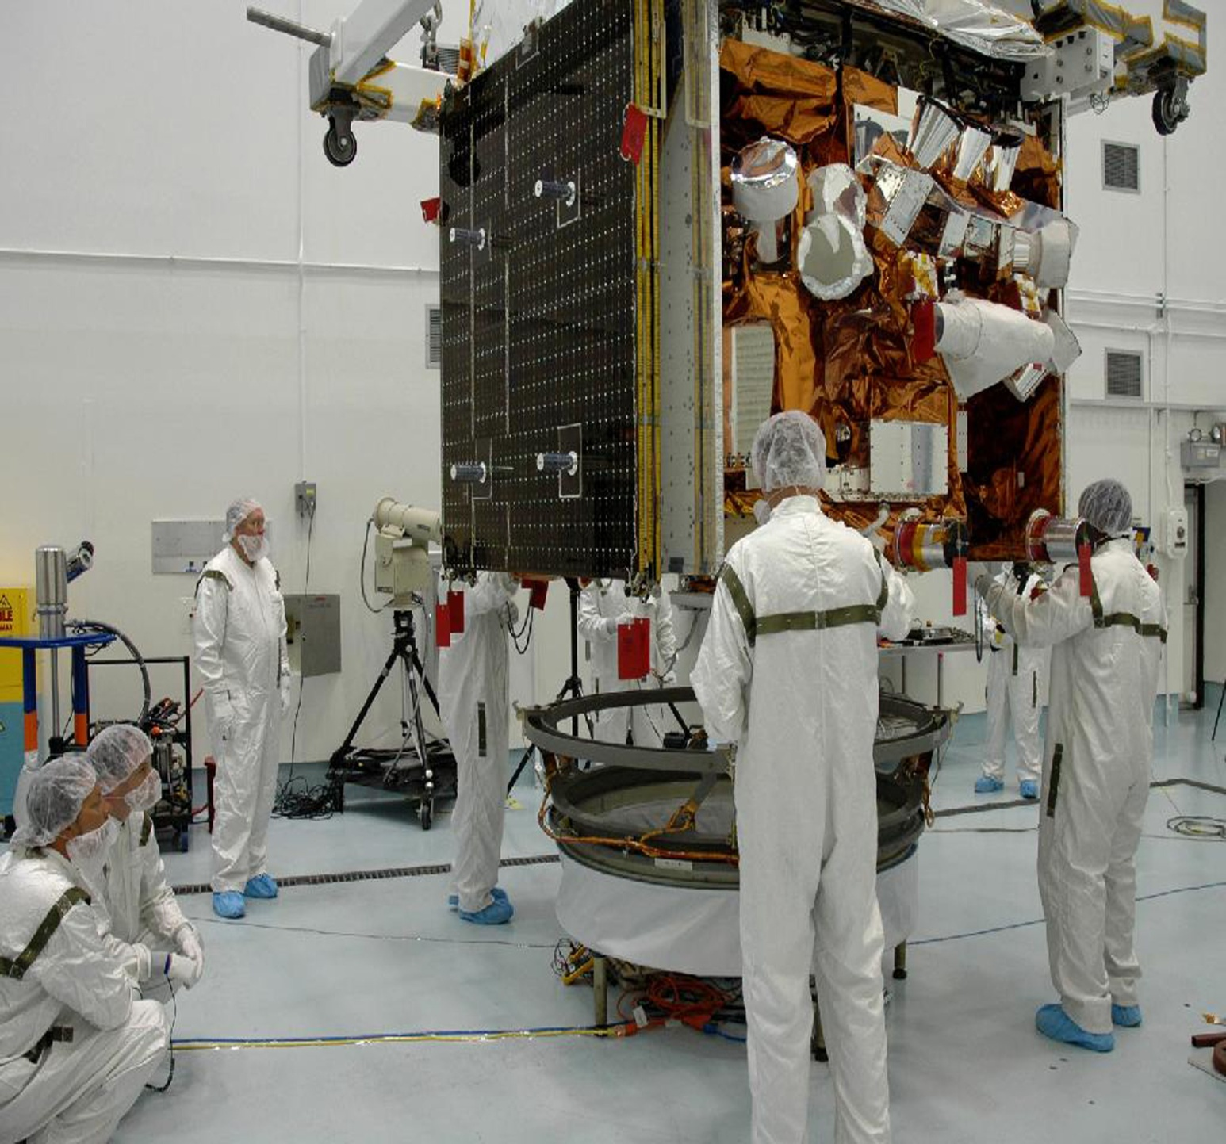
KEY FIGURES
3
3 100
researchers,
engineers and technicians
40 major international
projects
17 international research networks
© CENBG, LSM – Conception graphique : Anna Thibeau (IPNL)
77 M€
annual budget
(excluding salaries)
25 laboratories
and platforms

Slide 4
Notes:
La masse salariale et le FEI sur SE dépendent de l’axe M€
Les effectifs totaux et les effectifs permanents dépendent de l’axe Effectifs

Slide 5
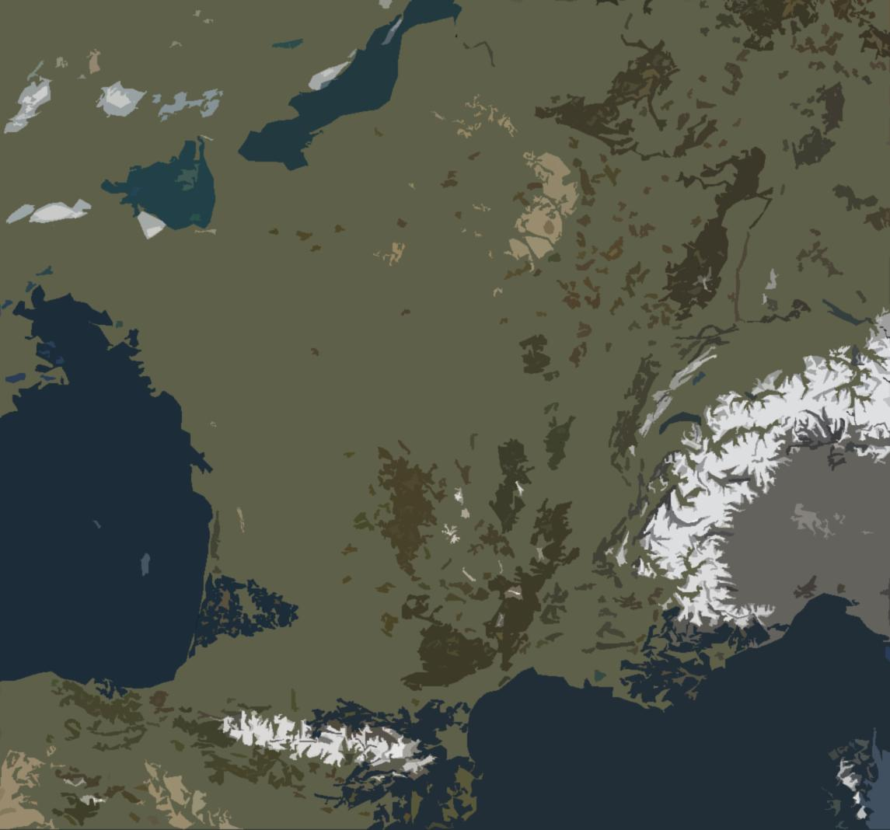
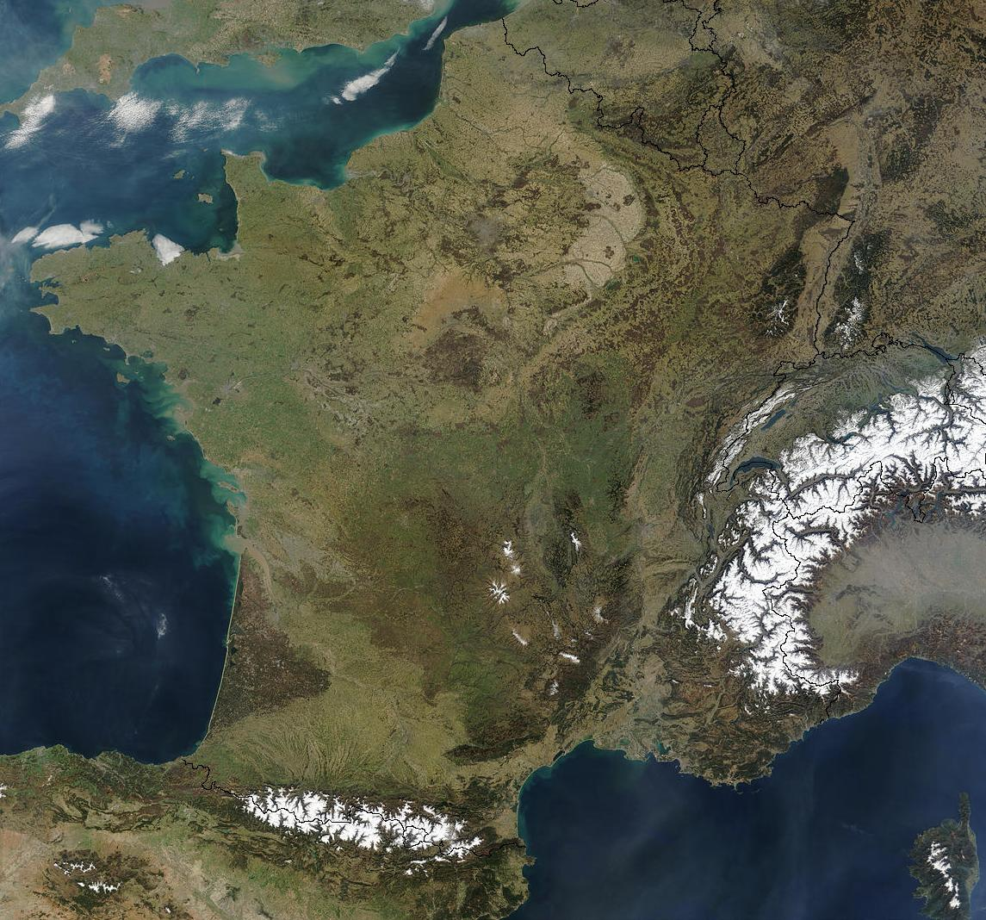
NETWORKED LABORATORIES
3
Ganil, LPC Caen
LNCA
APC, LPNHE,
Musée Curie
CSNSM
IMNC, IPNO, LAL, LLR, IDGC
IPHC
CC, IPNL, LMA
LSM, Lapp, Ulisse
Subatech
LPC Clermont
© CIA, LSM
CENBG
LPSC
LUPM
CPPM

Slide 6
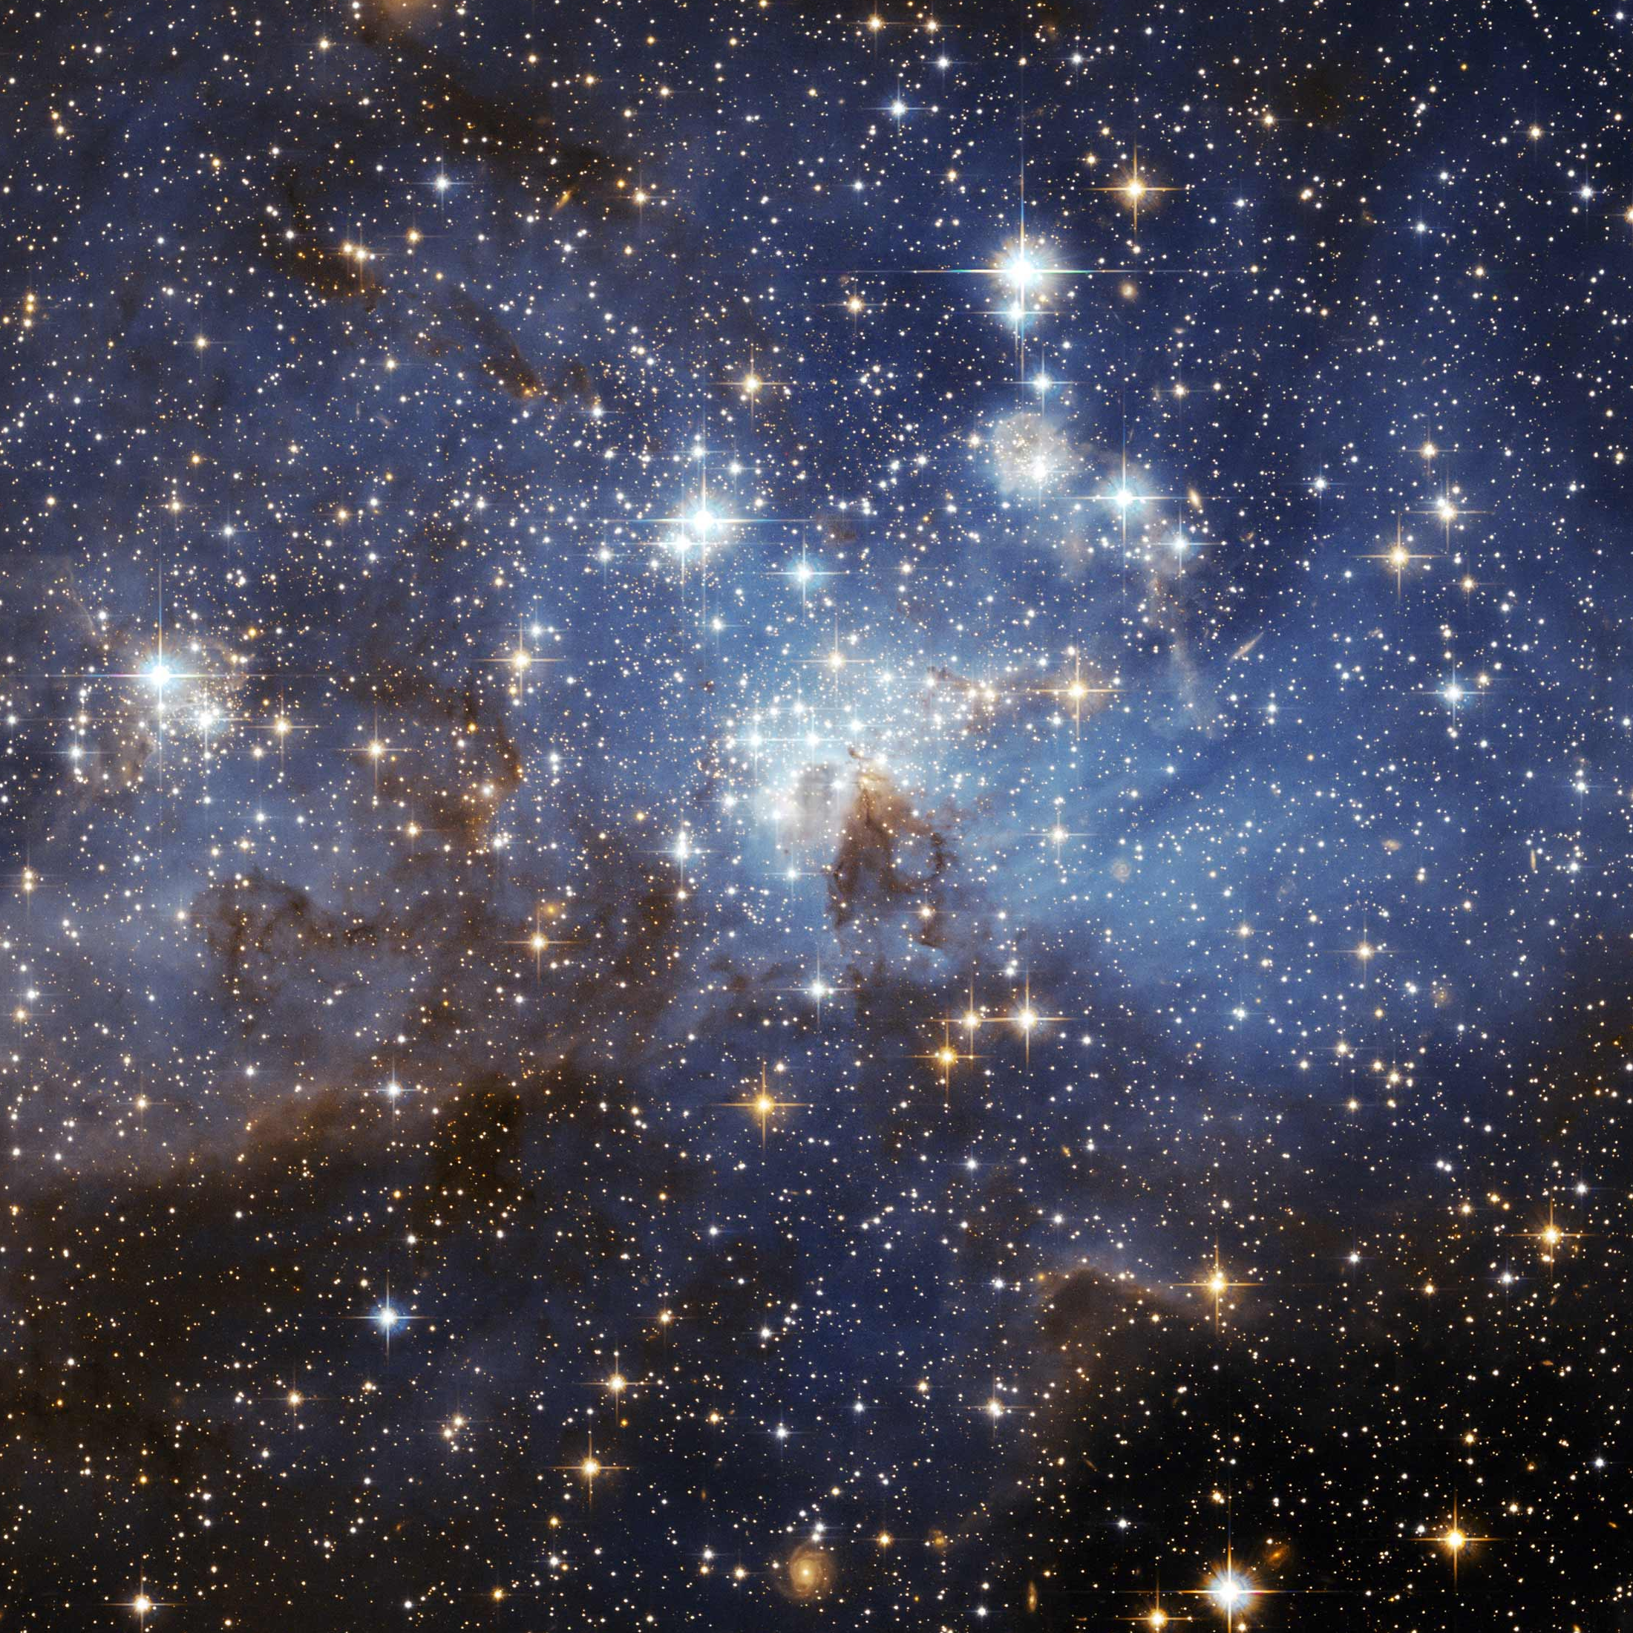
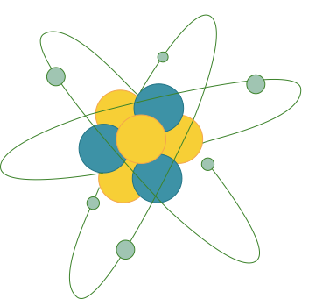
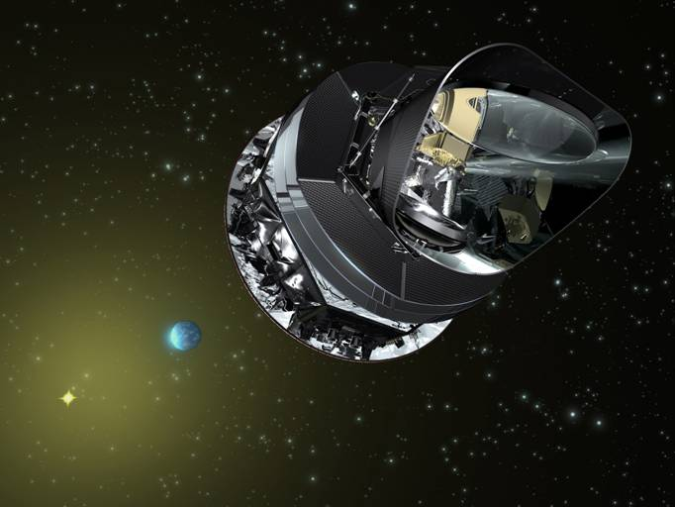
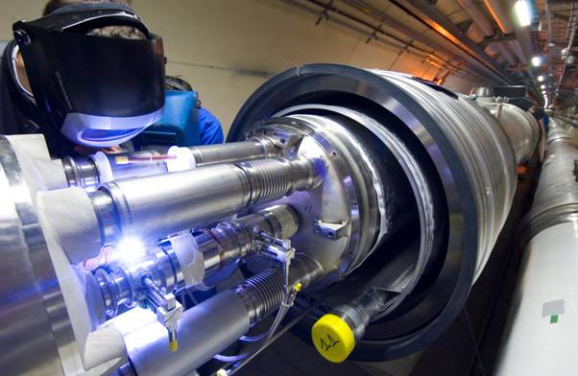
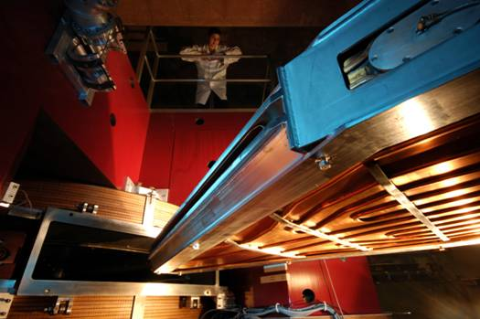
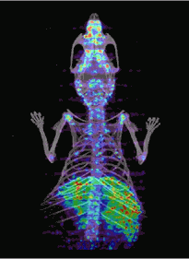
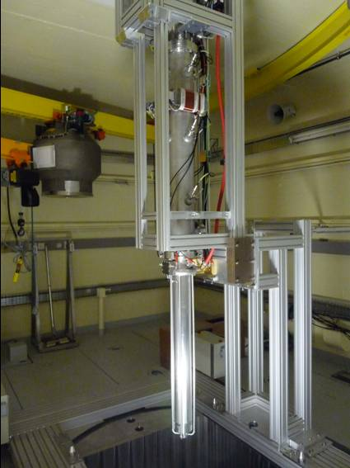
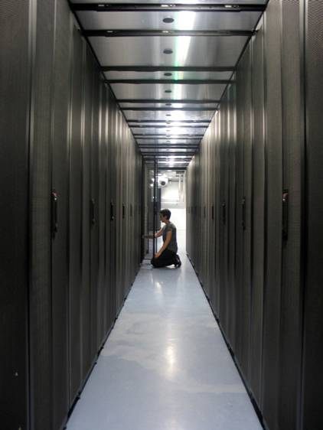
SCIENTIFIC THEMES
4
Astroparticle physics and neutrinos
Universe’s composition and behaviour
Particle physics
Nuclear and hadronic physics
Matter’s most elementary constituents and fundamental interactions
Structure of nuclear matter
Theory
Instrumentation
Computing grids
Accelerator R&D
Nuclear energy
Medical applications
© Ganil, Cern, CC-IN2P3, Guinevere, Amissa, Planck, LSM – Conception graphique : Anna Thibeau (IPNL)

Slide 7
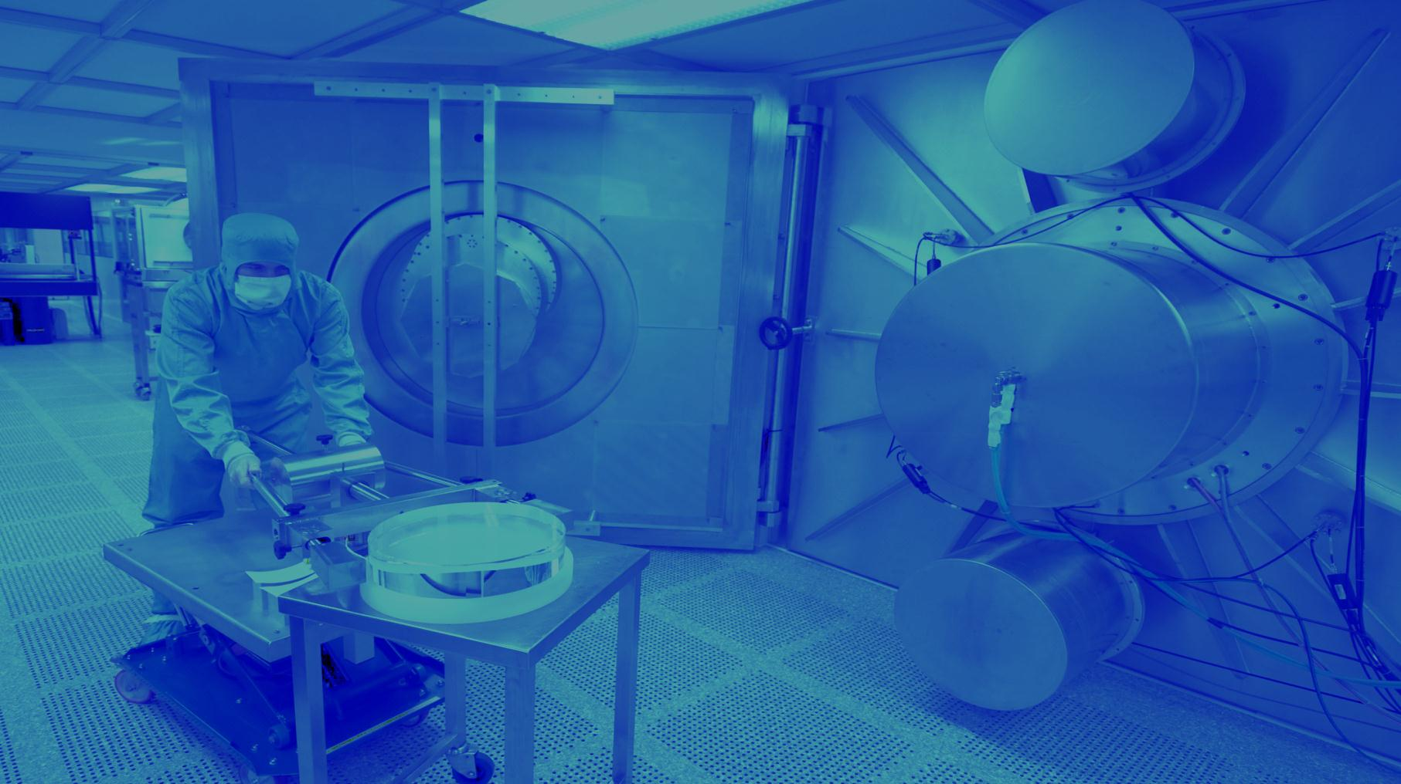
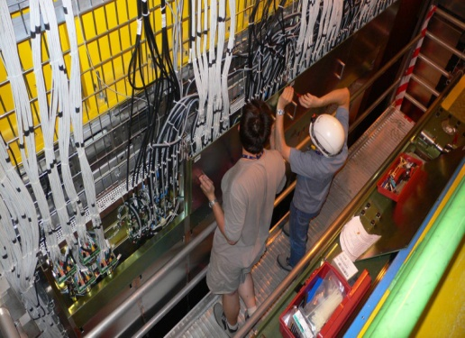
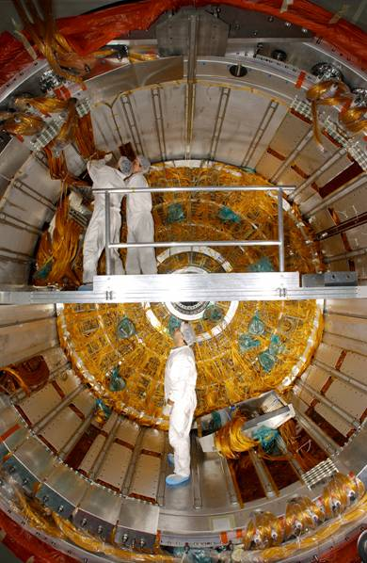
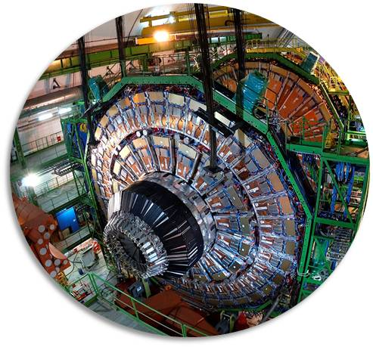
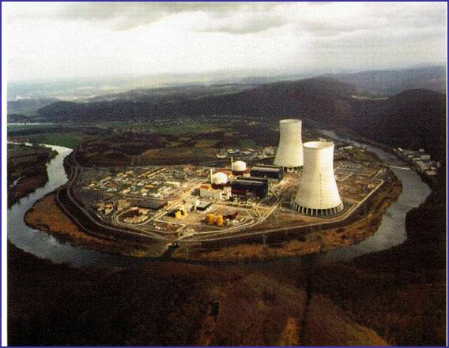
PARTICLE PHYSICS
5
ELEMENTARY CONSTITUENTS
ELEMENTARY CONSTITUENTS, FUNDAMENTAL INTERACTIONS
Particles’ mass
New physics
Supersymmetry
Antimatter
Neutrino’s nature and mass
Priorities:
LHC @14 TeV + upgrades
Neutrino Long Baseline
© Atlas, CMS, LHCb, Double Chooz, CNRS Photothèque / Hubert Raguet Conception graphique : Anna Thibeau (IPNL)
COLLISIONS
SUPERSYMMETRY
ANTIMATTER
HIGGS BOSON
DETECTORS
STANDARD MODEL

Slide 8
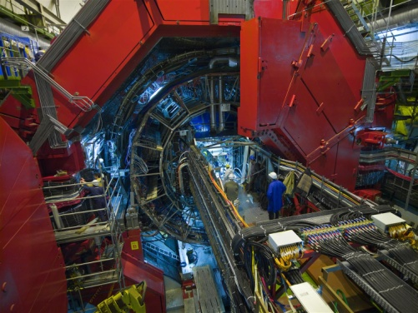
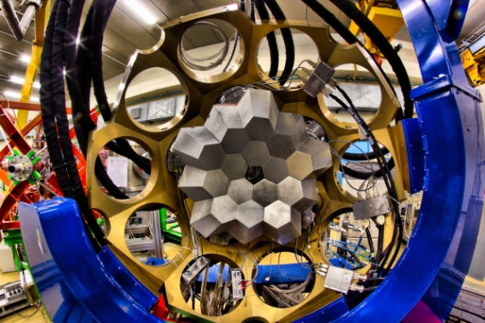
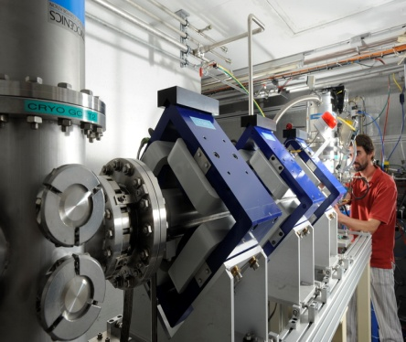
NUCLEAR PHYSICS
5
PROTON AND NUCLEUS
NUCLEON AND NUCLEI: THE EMERGENCE OF COMPLEXITY
Quark-gluon plasma
Proton’s structure
Nuclear structure
Exotic nuclei
Nuclear astrophysics
Priorities:
Ganil-Spiral2, LHC-Alice, JLab
© Agata, Alice, Fred Hulin/Scavo/Université Paris-Sud, Ganil/Philippe Stroppa, LSM, CNRS Photothèque / Hubert Raguet
Conception graphique : Anna Thibeau (IPNL)
EXTREME STATES
STABILITY
GLUONS
EXOTIC NUCLEI
SUPERHEAVY
QG PLASMA

Slide 9
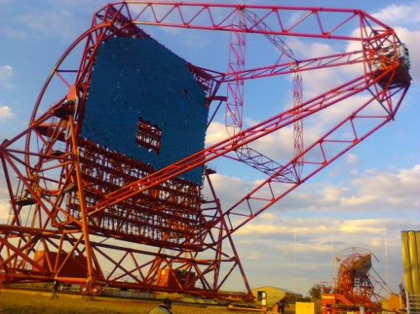
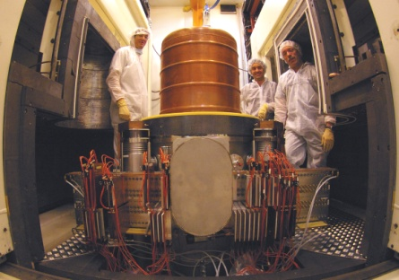
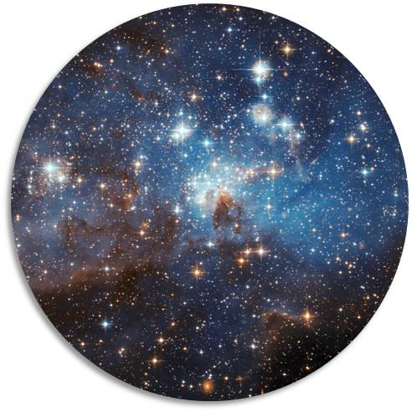
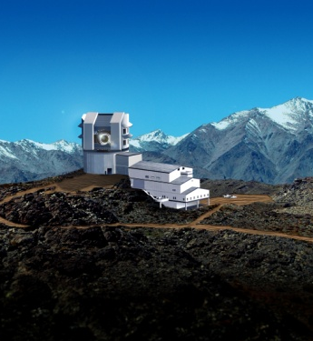
ASTROPARTICLE PHYSICS AND NEUTRINOS
5
UNIVERSE’S COMPOSITION
UNIVERSE’ S COMPOSITION AND BEHAVIOUR
Universe’s history
Dark matter and dark energy
Cosmic rays
Gravitational waves
Neutrinos
Priorities:
Virgo, LSST, Hess-CTA, Edelweiss,
SuperNemo,
DChooz, Auger
© LSST, Hess, Nasa, LSM, CNRS Photothèque / Hubert Raguet Conception graphique : Anna Thibeau (IPNL)
COSMIC RAYS
UNIVERSE
BIG BANG
DARK ENERGY
SUPERNOVAE
GRAVITATIONAL

Slide 10
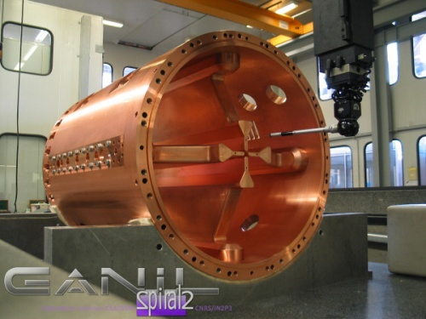
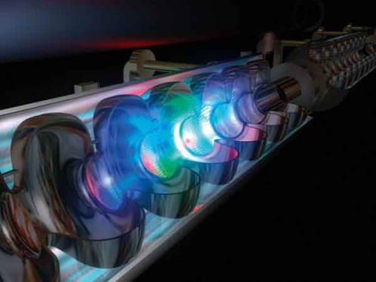
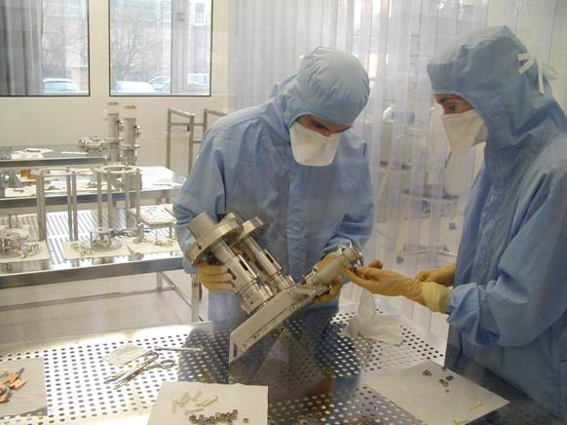
ACCELERATOR RESEARCH AND DEVELOPMENT
5
ACCELERATOR R&D
ACCELERATOR R&D, TECHNOLOGICAL PLATFORMS
Superconducting accelerator cavities and cryotechnology
Ion and electron sources
Target/source for radioactive beams
Beam dynamics
Laser acceleration
© CSNSM/Jean François Dars, Desy Hamburg, Ganil, CNRS/IN2P3 Conception graphique : Anna Thibeau (IPNL)
INTENSE BEAMS
LASERS
SUPERCONDUCTING
ION SOURCES
PLATFORMS
CRYOTECHNOLOGY

Slide 11
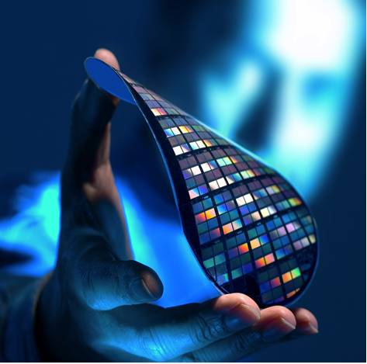
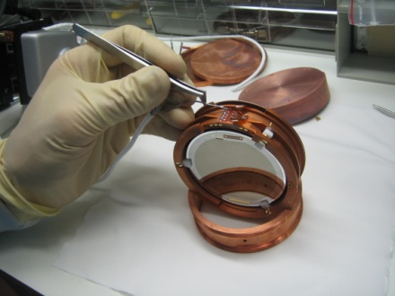
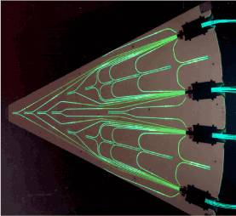
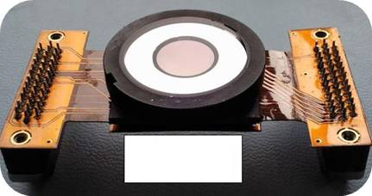
INSTRUMENTATION AND DETECTORS
5
INSTRUMENTATION
INSTRUMENTATION, DETECTORS, TECHNOLOGY TRANSFER
Silicon detectors
Photo-detectors, new generation scintillators
Gaseous detectors
Bolometers
Microelectronics
© LSM, D.R., IPNL – Conception graphique : Anna Thibeau (IPNL)
MICROELECTRONIcs
BOLOMETERS
CMOS
HODOSCOPES
IMAGERS
Ultra-granulary

Slide 12
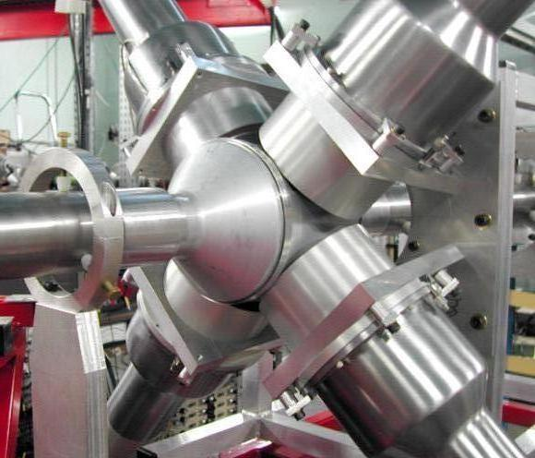
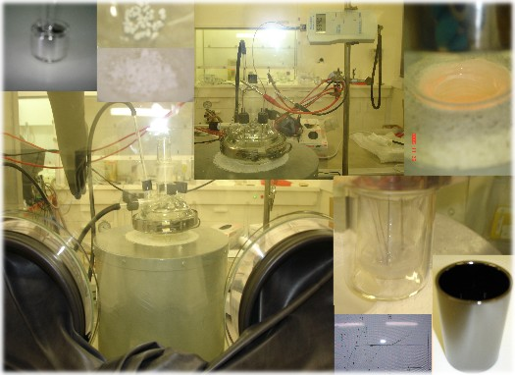
NUCLEAR PHYSICS AND ENERGY
5
BACK-END OF THE NUCL
BACK-END OF THE NUCLEAR FUEL CYCLE, NUCLEAR ENERGY
Transmutation of nuclear waste by ADS
Innovating nuclear systems with low wastes (thorium)
Waste storage radiochemistry
© Pacen, Gedepeon, Guinevere – Conception graphique : Anna Thibeau (IPNL)
TRANSMUTATION
MOLTEN SALTS
REACTORS
RADIOCHEmIstry
NUCLEAR WASTES
ADS

Slide 13
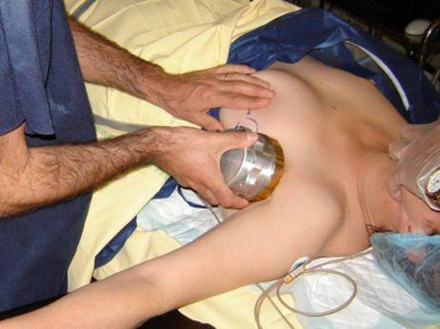
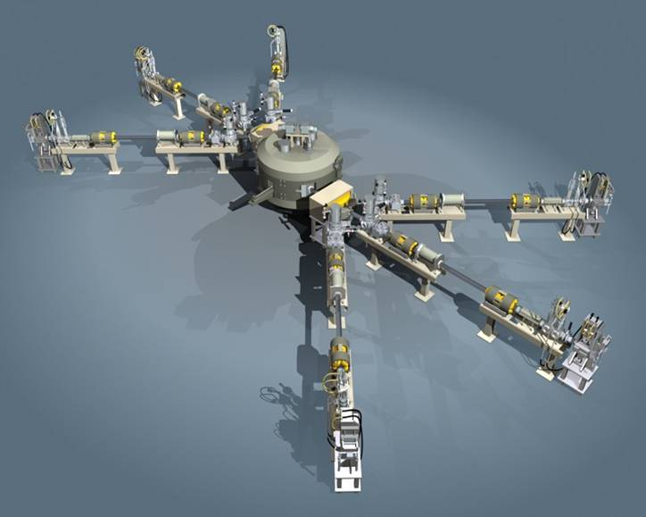
NUCLEAR PHYSICS AND HEALTH
5
NEW DIAGNOSTIC AND TH
NEW DIAGNOSTIC AND THERAPY TOOLS
Strong involvement of IN2P3 in the fight against cancer
Radioisotopes, radiobiology, radiotherapy
Dosimetry / beam monitors R&D
Accelerator technology
Imaging, simulations (Geant, Gate)
© Amissa, IMNC/CNRS, Arronax – Conception graphique : Anna Thibeau (IPNL)
BEAM MONITORS
SIMULATIONS
IMAGING
radiobiologY
HADRONTHERAPY
RADIOISOTOPES

Slide 14
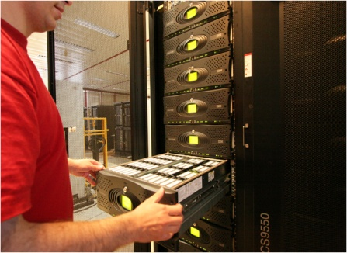
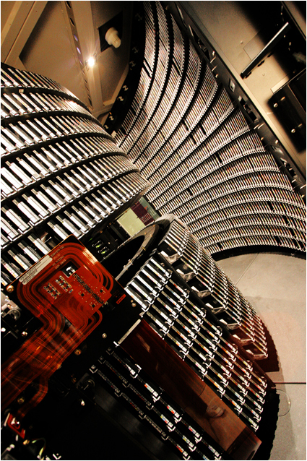
COMPUTING GRIDS
5
LARGE DATA-SET PROCE
LARGE DATA-SET PROCESSING
European and International level
Major contribution of CC-IN2P3 (Lyon) and TIER-2’s
High energy physics (LCG)
Biomedical applications
© CC-IN2P3/CNRS/F. de Stefanis – Conception garphique : Anna Thibeau (IPNL)
infrastructures
DATA STORAGE
NETWORKS
COMPUTING CENTERS
INTERFACES
LCG

Slide 15
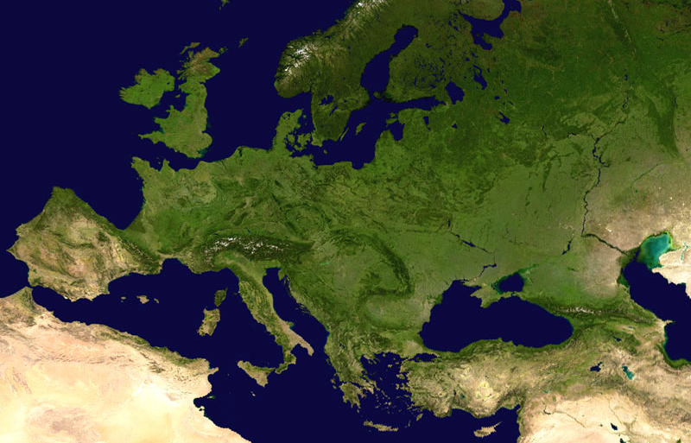
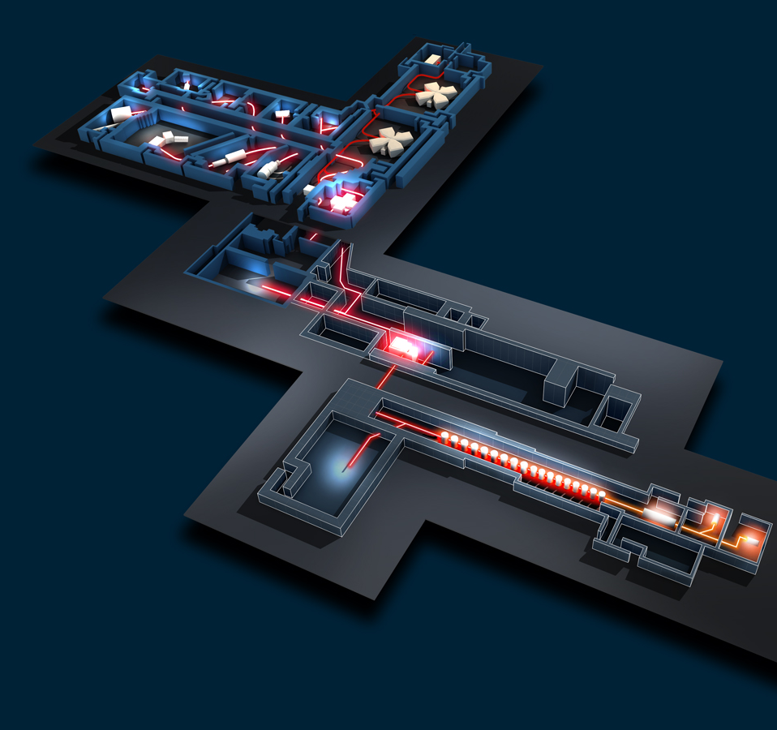
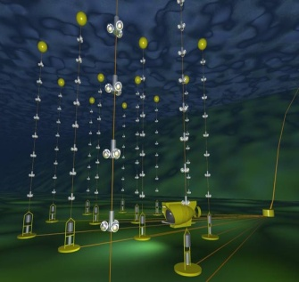
FRANCE : LARGE INFRASTRUCTURES
3
Spiral2 / Ganil
DChooz
CC-IN2P3
Edelweiss, Nemo / LSM
Antares
© Ganil/Spiral2, CNRS/IN2P3, coll. Edelweiss, Antares, DChooz, Nasa – Conception graphique : Anna Thibeau (IPNL)

Slide 16
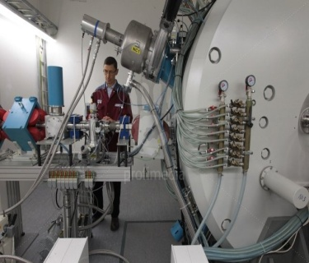
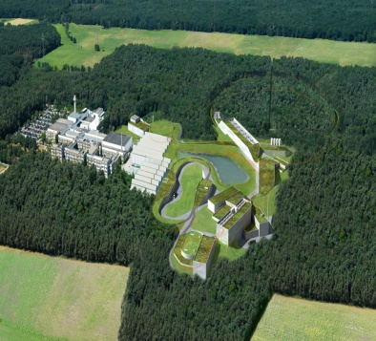
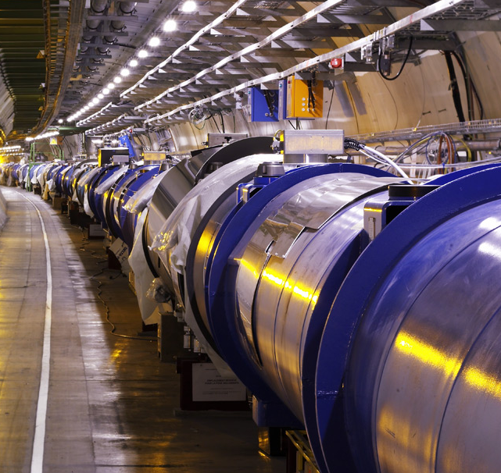
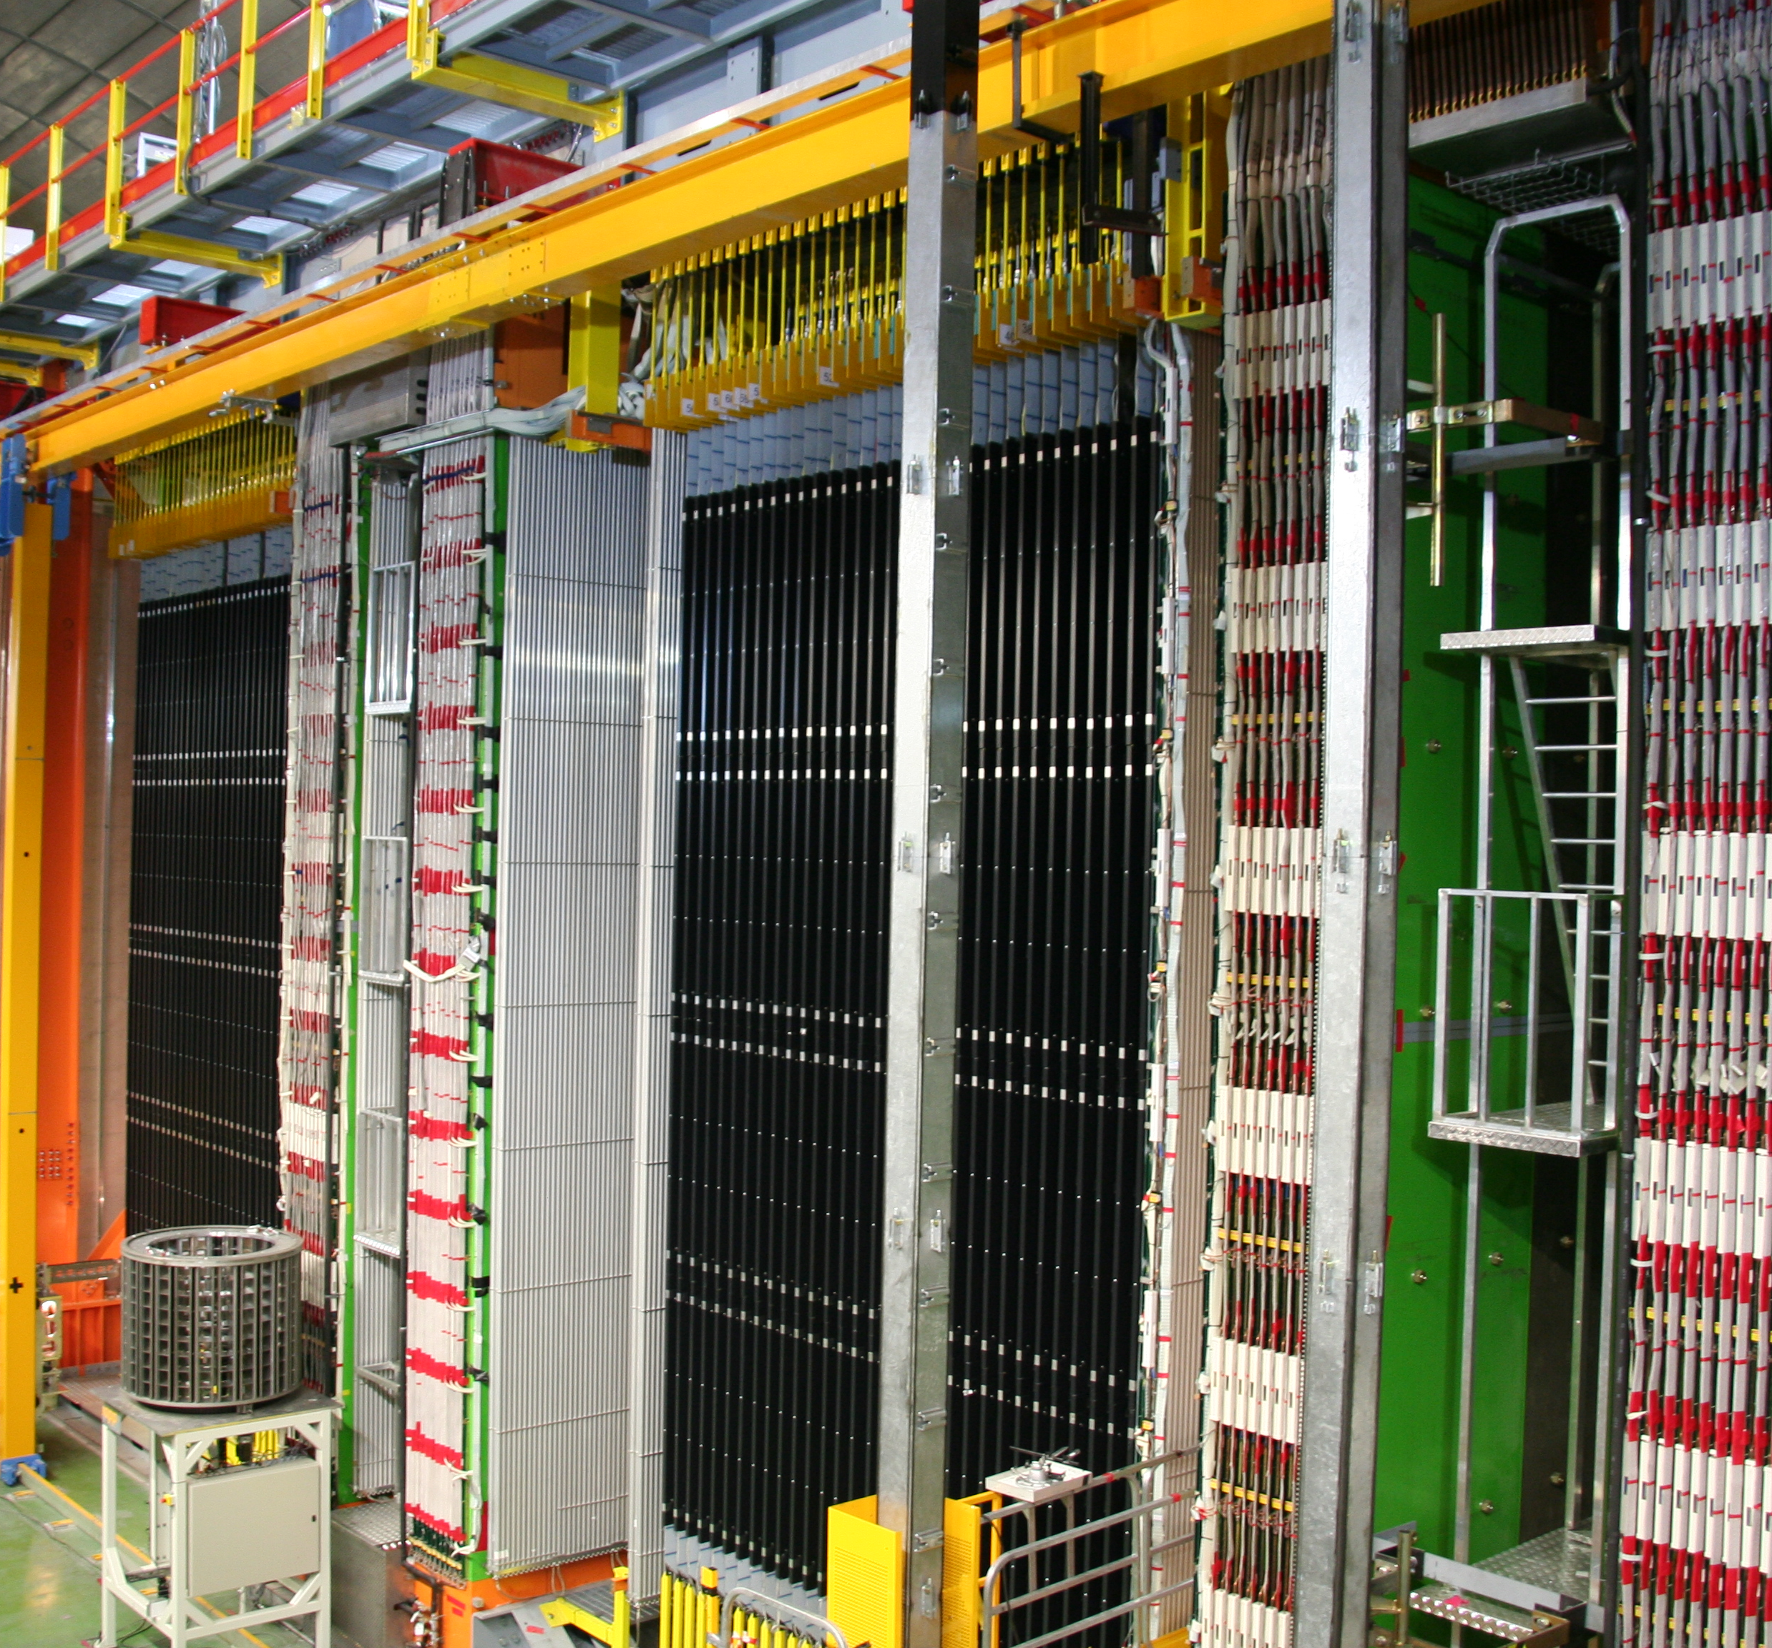
INTERNATIONAL COLLABORATIONS
3
Jyväskylä (Finland)
Fair / GSI (Germany)
JINR Dubna (Russia)
LHC, Isolde / Cern (Switzerland)
© Cern, Nasa, Opera, GSI, JINR Dubna, Profilmedia – Conception graphique : Anna Thibeau (IPNL)
Opera, Xenon / Gran Sasso Virgo (Italia)

Slide 17
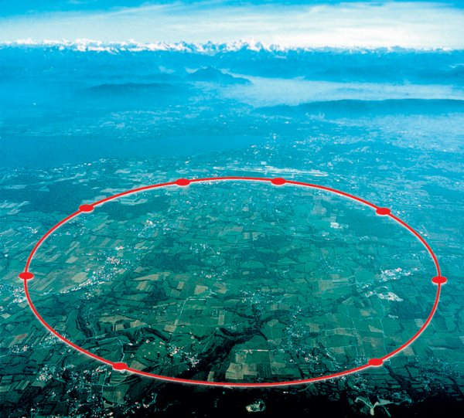
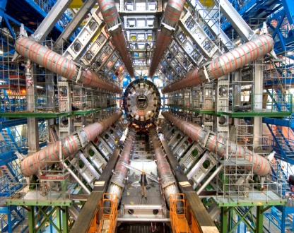
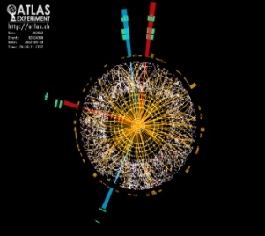
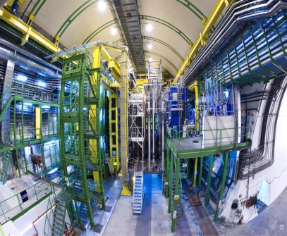
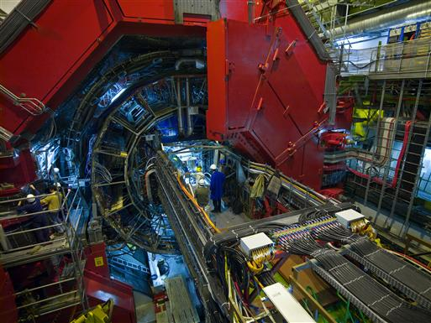
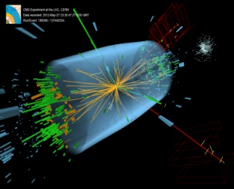
INTERNATIONAL COLLABORATIONS
3
LHC:
IN2P3 PARTICIPATION
75 M€*(experiments construction)
>500 engineers,technicians/year (over 6-8 years of construction)
106 FTP.year (accelerator)
~250 researchers
80 PhD students
106
40
43
11
Atlas
LHCb
Alice
© Cern
48
10
51
20
CMS
* excluding salaries

Slide 18
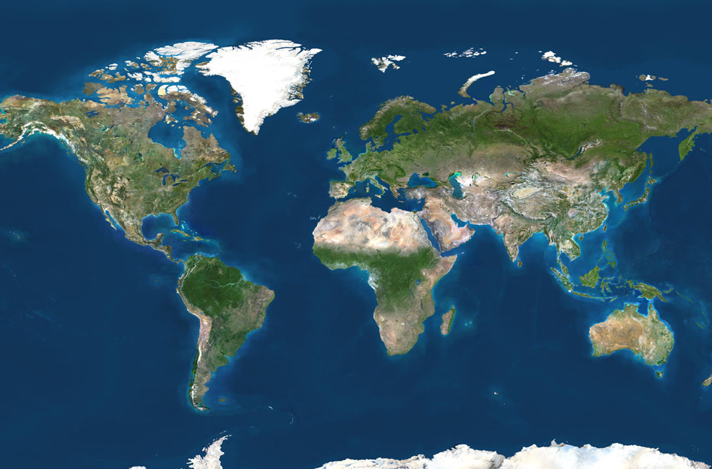
INTERNATIONAL COLLABORATIONS
3
DØ, CDF Tevatron
© Star/Phenix, Kamioka Observatory/ICRR/Université de Tokyo, Auger, Hess, ESA/Nasa, J.-P. Kneib (Observatoire Midi-Pyrénées) and R. Ellis (Caltech) – Conception graphique : Anna Thibeau (IPNL)
Star, Phenix Rhic, BNL
SNFactory (Hawaï)
Jlab
T2K / Jparc, Riken (Japan)
Hess (Namibia)
Fermi, AMS, Lisa Planck, Euclid
(Space)
LSST (Chili)
Auger (Argentina)
CTA

Slide 19
LINKS WITH INDUSTRY
5
INDUSTRIAL PARTNERSHI
INDUSTRIAL PARTNERSHIP AND APPLICATIONS
Expertise / high technology resources transferred to industry
Health (medical imaging)
Space industry
Environment (radioactivity measurements, Becquerel network)
Electronics
© Amissa, D.R., Arcane/CENBG – Conception graphique : Anna Thibeau (IPNL)
MICROELECTRONIcs
PRECISION OPTICS
TECHNOL
MEDICAL IMAGING
SIMULATIONS
EXPERTISE

Slide 20
HIGHER EDUCATION
5
PARTNERSHIP, CONTRAC
PARTNERSHIP, CONTRACTUALISATION, TRAINING, TEACHING
IN2P3 projects → visibility of universities/grandes écoles (Europe and International)
Laboratory “UMR” contracts
Regular meetings IN2P3 / Universities’ presidents
Teaching
Students’ training
© Université Claude Bernard Lyon 1, D.R. – Conception graphique : Anna Thibeau (IPNL)
LABORATORIES
COLLABORATIONS
TRAINING
YOUNG RESEARCHERS
CONTRACTS
VISIBILITY

Slide 21
COMMUNICATIONS
5
INCREASING VISIBILITY
INCREASING VISIBILITY, PROMOTING RESEARCH ACTIVITIES
Press and media
Conferences
Education/teacher programs and resources (Masterclasses, “Cosmos à l’école”…)
Partnership and networks (IN2P3 labs, Cern, CEA, “Science à l’école”, Interactions, Ippog)
Publications, website, exhibitions…
© LSM, LAL, École Polytechnique – Conception graphique : Anna Thibeau (IPNL)
exhibitions
PRESS AND MEDIA
PROMOTION
Education programs
NETWORKS
VISIBILITY

