Slide 1
Jacques Martino IN2P3 Director
IN2P3 CSI meeting
Paris June 2013
www.in2p3.fr

Slide 2
With my sincere apologies Jacques
3
© CENBG, LSM Conception graphique : Anna Thibeau (IPNL)

Slide 3
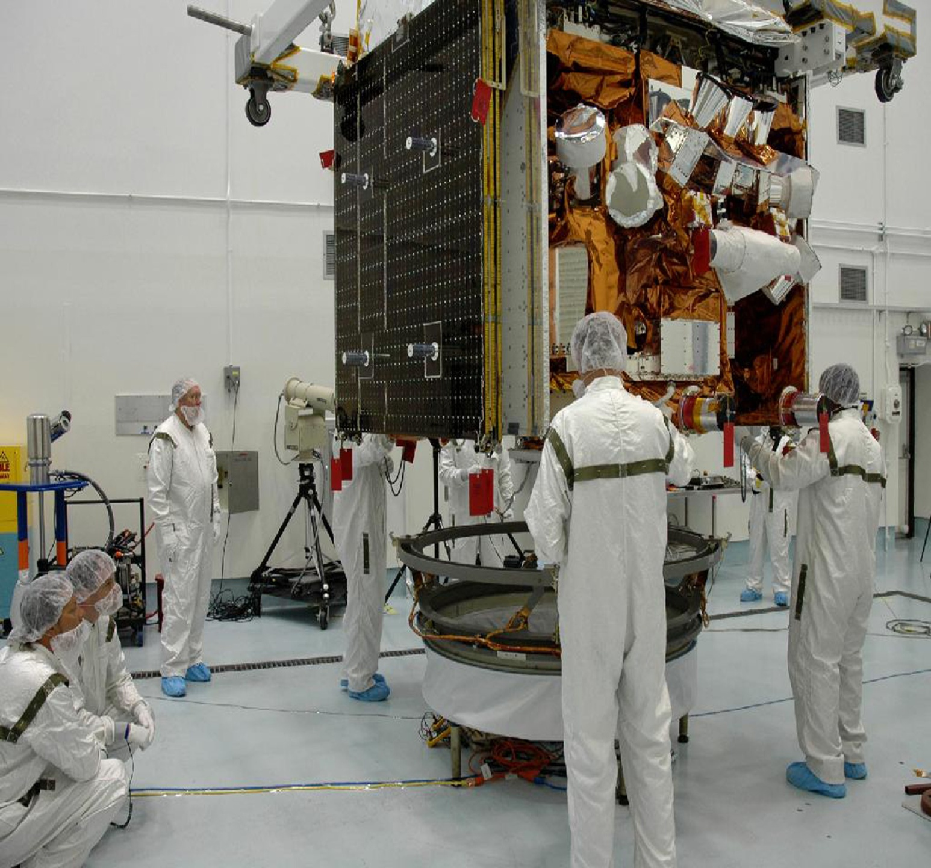
IN2P3 KEY FIGURES
3
3 100
researchers,
engineers and technicians
40 major international
projects
17 international research networks
© CENBG, LSM – Conception graphique : Anna Thibeau (IPNL)
77 M€
annual budget
(excluding salaries)
25 laboratories
and platforms

Slide 4
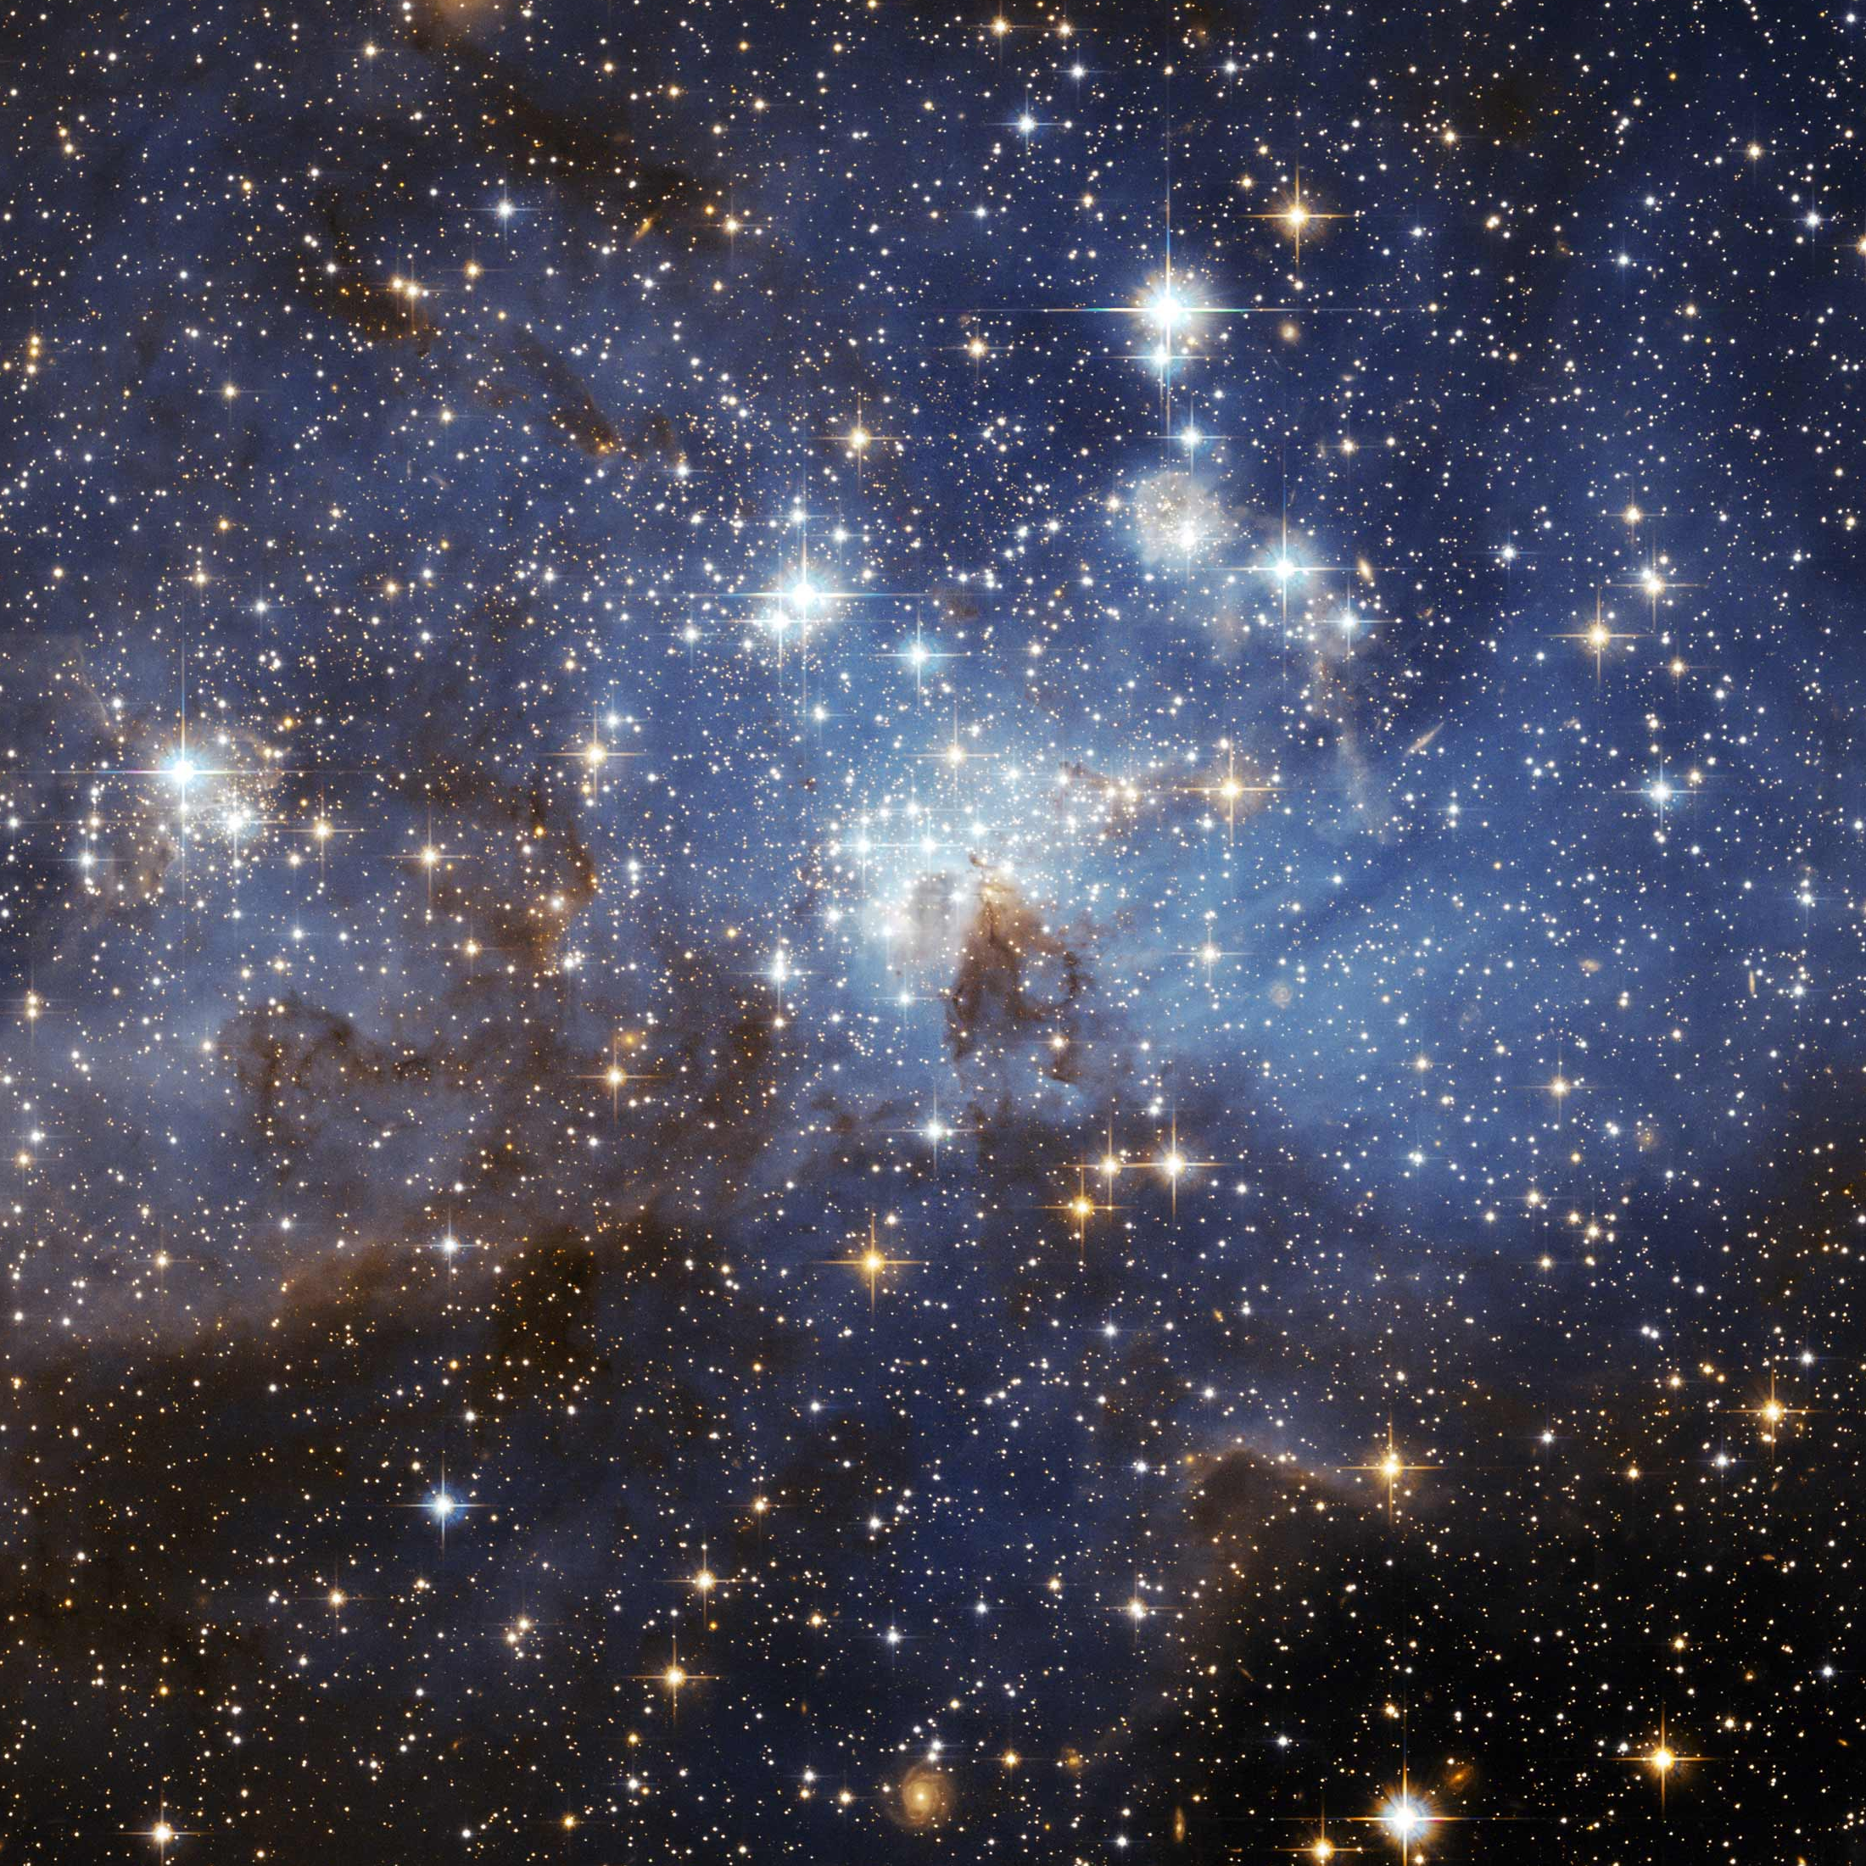
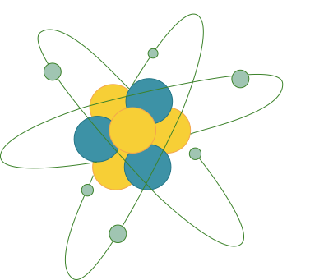
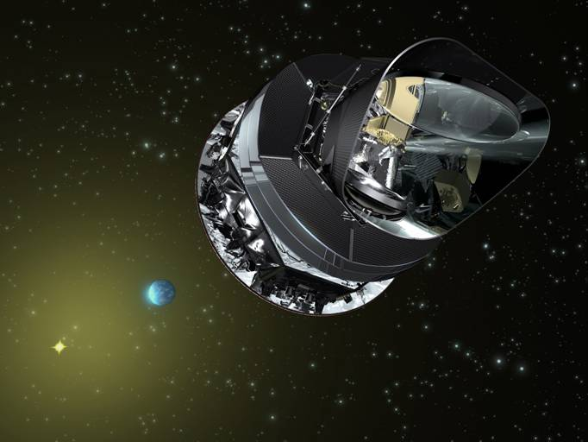
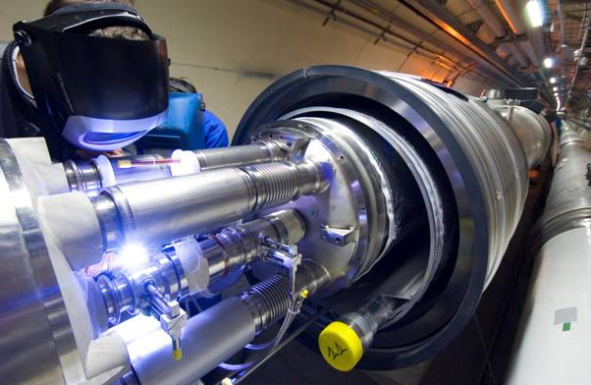
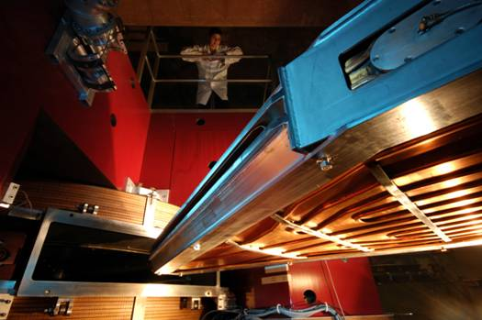
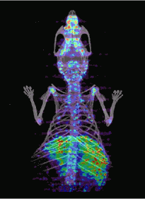
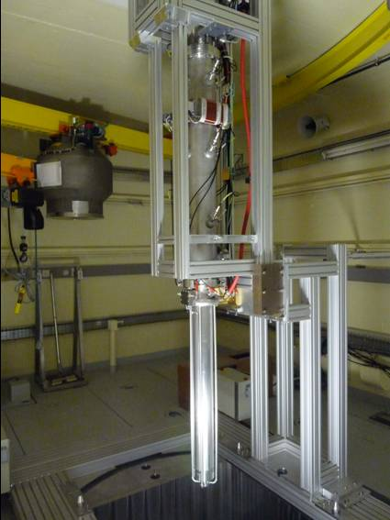
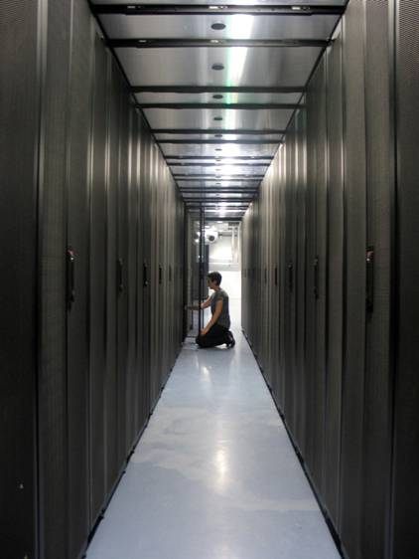
SCIENTIFIC THEMES
4
Astroparticle physics and neutrinos
Universe’s composition and behaviour
Particle physics
Nuclear and hadronic physics
Matter’s most elementary constituents and fundamental interactions
Structure of nuclear matter
Theory
Instrumentation
Computing grids
Accelerator R&D
Nuclear energy
Medical applications
© Ganil, Cern, CC-IN2P3, Guinevere, Amissa, Planck, LSM – Conception graphique : Anna Thibeau (IPNL)

Slide 5
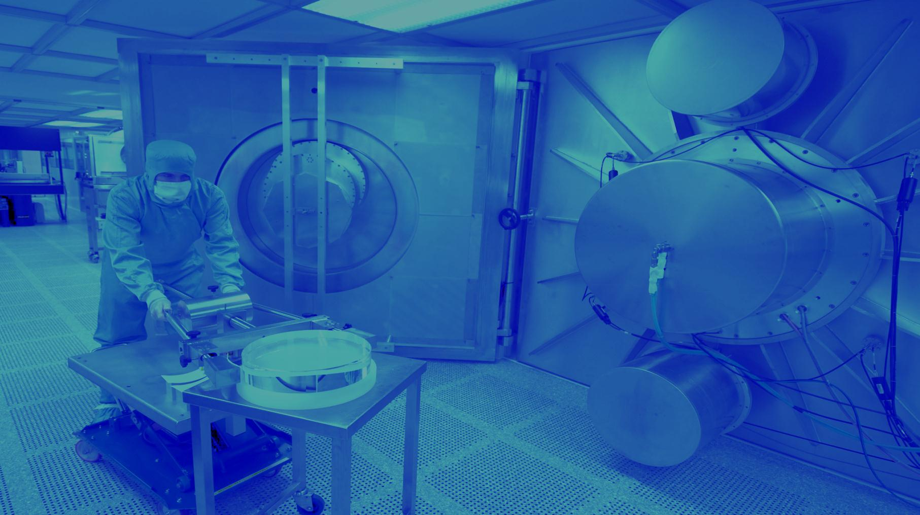
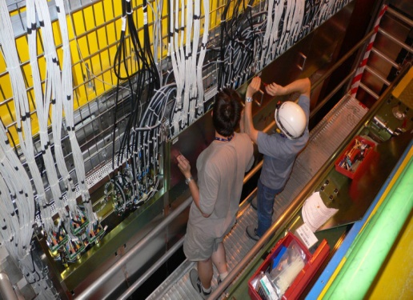
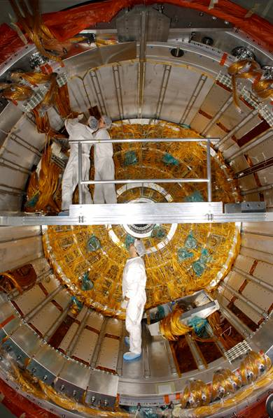
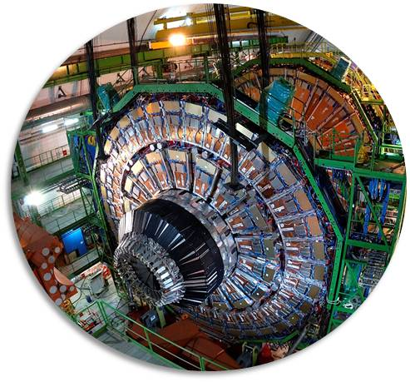
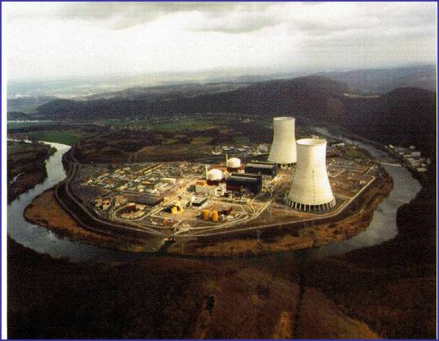
PARTICLE PHYSICS
5
ELEMENTARY CONSTITUENTS
ELEMENTARY CONSTITUENTS, FUNDAMENTAL INTERACTIONS
Particles’ mass
New physics
Supersymmetry
Antimatter
Neutrino’s nature and mass
© Atlas, CMS, LHCb, Double Chooz, CNRS Photothèque / Hubert Raguet Conception graphique : Anna Thibeau (IPNL)
COLLISIONS
SUPERSYMMETRY
ANTIMATTER
HIGGS BOSON
DETECTORS
STANDARD MODEL

Slide 6
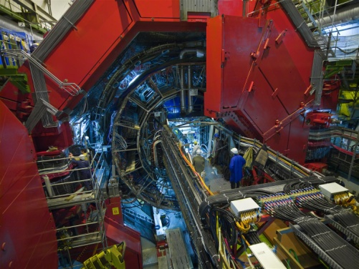
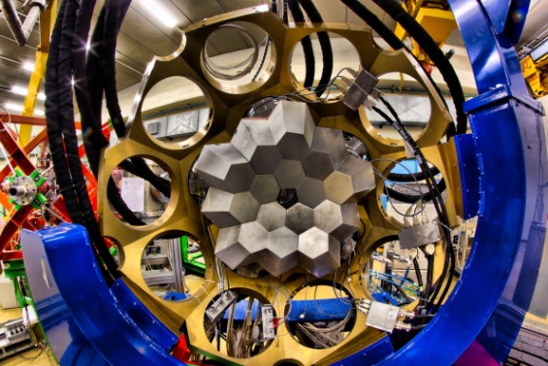
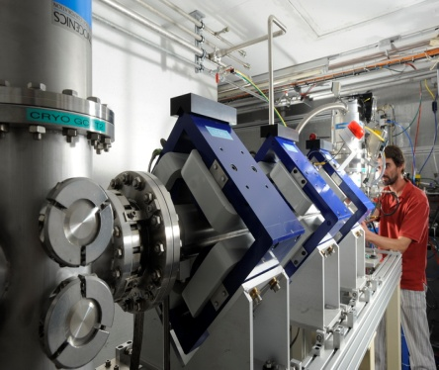
NUCLEAR PHYSICS
5
PROTON AND NUCLEUS
NUCLEON AND NUCLEI: THE EMERGENCE OF COMPLEXITY
Quark-gluon plasma
Proton’s structure
Nuclear structure
Exotic nuclei
Nuclear astrophysics
© Agata, Alice, Fred Hulin/Scavo/Université Paris-Sud, Ganil/Philippe Stroppa, LSM, CNRS Photothèque / Hubert Raguet
Conception graphique : Anna Thibeau (IPNL)
EXTREME STATES
STABILITY
GLUONS
EXOTIC NUCLEI
SUPERHEAVY
QG PLASMA

Slide 7
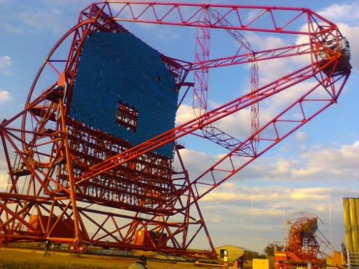
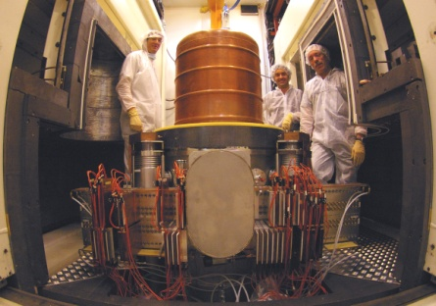
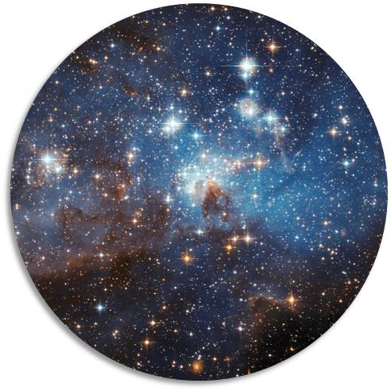
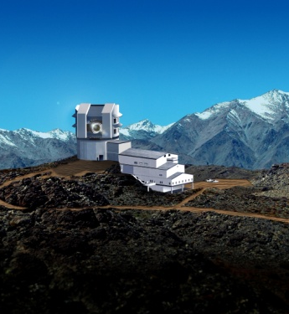
ASTROPARTICLE PHYSICS AND NEUTRINOS
5
UNIVERSE’S COMPOSITION
UNIVERSE’ S COMPOSITION AND BEHAVIOUR
Universe’s history
Dark matter and dark energy
Cosmic rays
Gravitational waves
Neutrinos
© LSST, Hess, Nasa, LSM, CNRS Photothèque / Hubert Raguet Conception graphique : Anna Thibeau (IPNL)
COSMIC RAYS
UNIVERSE
BIG BANG
DARK ENERGY
SUPERNOVAE
GRAVITATIONAL

Slide 8
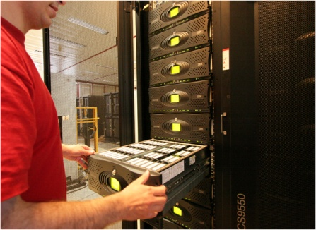
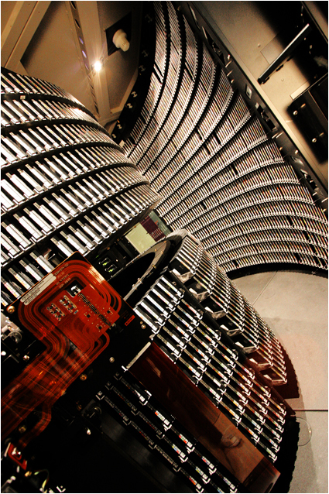
COMPUTING GRIDS
5
LARGE DATA-SET PROCE
LARGE DATA-SET PROCESSING
European and International level
Major contribution of CC-IN2P3 (Lyon) and TIER-2’s
High energy physics (LCG)
Biomedical applications
© CC-IN2P3/CNRS/F. de Stefanis – Conception garphique : Anna Thibeau (IPNL)
infrastructures
DATA STORAGE
NETWORKS
COMPUTING CENTERS
INTERFACES
LCG

Slide 9
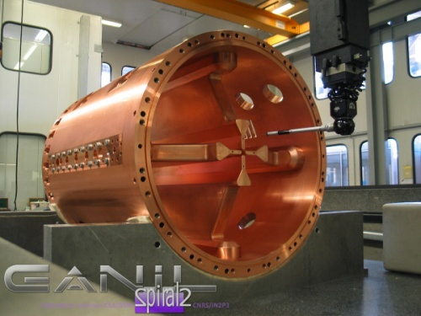
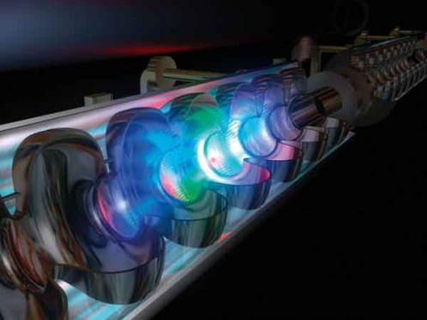
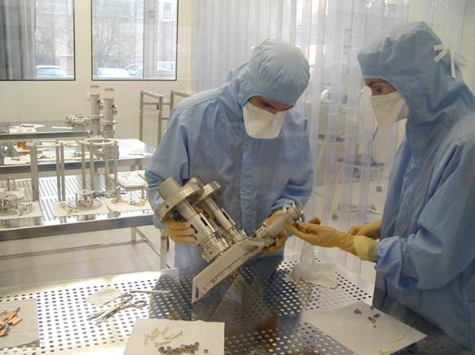
ACCELERATOR RESEARCH AND DEVELOPMENT
5
ACCELERATOR R&D
ACCELERATOR R&D, TECHNOLOGICAL PLATFORMS
Superconducting accelerator cavities and cryotechnology
Ion and electron sources
Target/source for radioactive beams
Beam dynamics
Laser acceleration
© CSNSM/Jean François Dars, Desy Hamburg, Ganil, CNRS/IN2P3 Conception graphique : Anna Thibeau (IPNL)
INTENSE BEAMS
LASERS
SUPERCONDUCTING
ION SOURCES
PLATFORMS
CRYOTECHNOLOGY

Slide 10
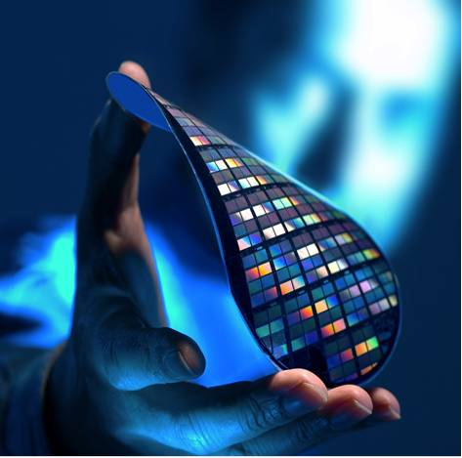
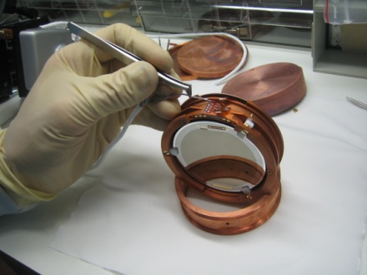
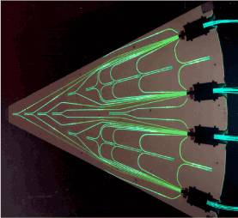
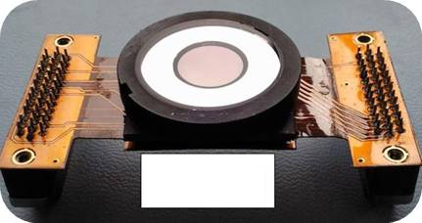
INSTRUMENTATION AND DETECTORS
5
INSTRUMENTATION
INSTRUMENTATION, DETECTORS, TECHNOLOGY TRANSFER
Silicon detectors
Photo-detectors, new generation scintillators
Gaseous detectors
Bolometers
Microelectronics
© LSM, D.R., IPNL – Conception graphique : Anna Thibeau (IPNL)
MICROELECTRONIcs
BOLOMETERS
CMOS
HODOSCOPES
IMAGERS
Ultra-granulary

Slide 11
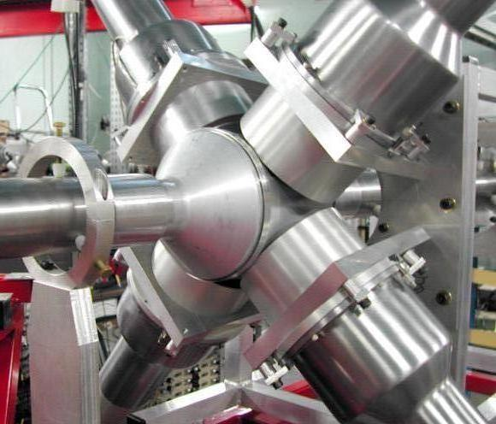
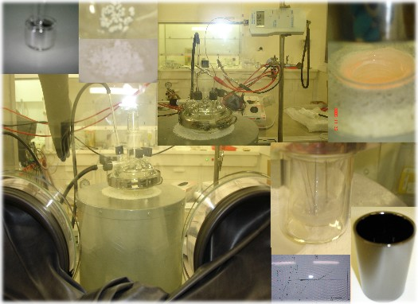
NUCLEAR PHYSICS AND ENERGY
5
BACK-END OF THE NUCL
BACK-END OF THE NUCLEAR FUEL CYCLE, NUCLEAR ENERGY
Transmutation of nuclear waste by ADS
Innovating nuclear systems with low wastes (thorium)
Waste storage radiochemistry
© Pacen, Gedepeon, Guinevere – Conception graphique : Anna Thibeau (IPNL)
TRANSMUTATION
MOLTEN SALTS
REACTORS
RADIOCHEmIstry
NUCLEAR WASTES
ADS

Slide 12
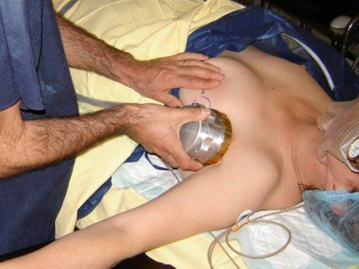
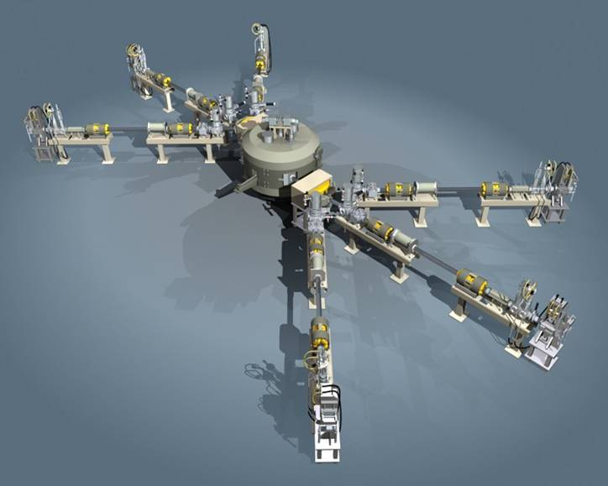
NUCLEAR PHYSICS AND HEALTH
5
NEW DIAGNOSTIC AND TH
NEW DIAGNOSTIC AND THERAPY TOOLS
Strong involvement of IN2P3 in the fight against cancer
Radioisotopes, radiobiology, radiotherapy
Dosimetry / beam monitors R&D
Accelerator technology
Imaging, simulations (Geant, Gate)
© Amissa, IMNC/CNRS, Arronax – Conception graphique : Anna Thibeau (IPNL)
BEAM MONITORS
SIMULATIONS
IMAGING
radiobiologY
HADRONTHERAPY
RADIOISOTOPES

Slide 13
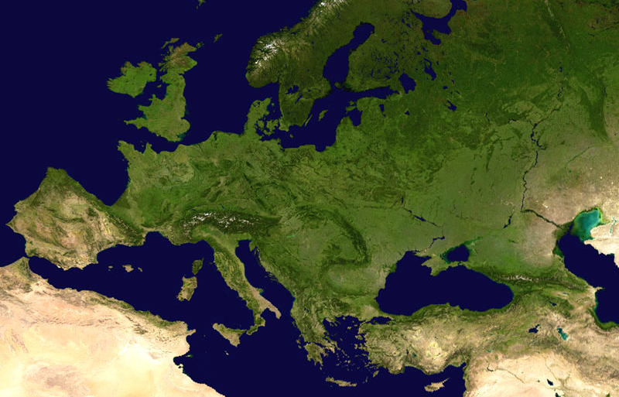
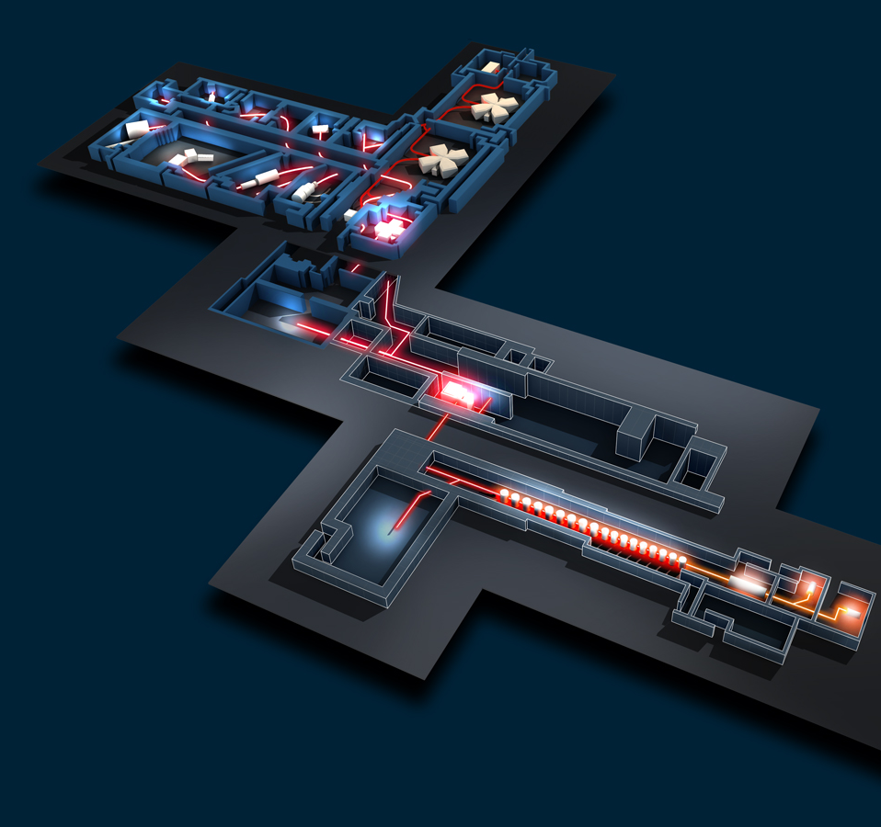
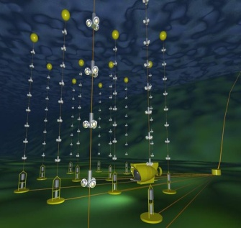
FRANCE : LARGE INFRASTRUCTURES
3
Spiral2 / Ganil
DChooz
CC-IN2P3
Edelweiss, Nemo / LSM
Antares
© Ganil/Spiral2, CNRS/IN2P3, coll. Edelweiss, Antares, DChooz, Nasa – Conception graphique : Anna Thibeau (IPNL)

Slide 14
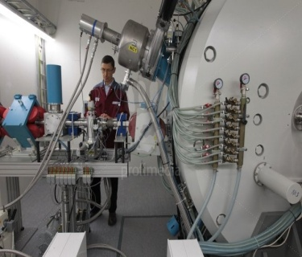
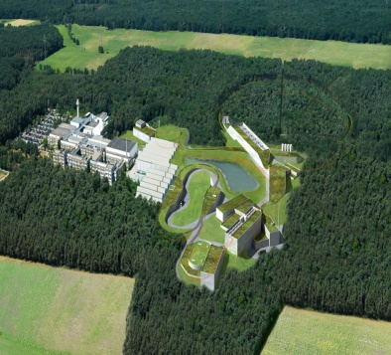
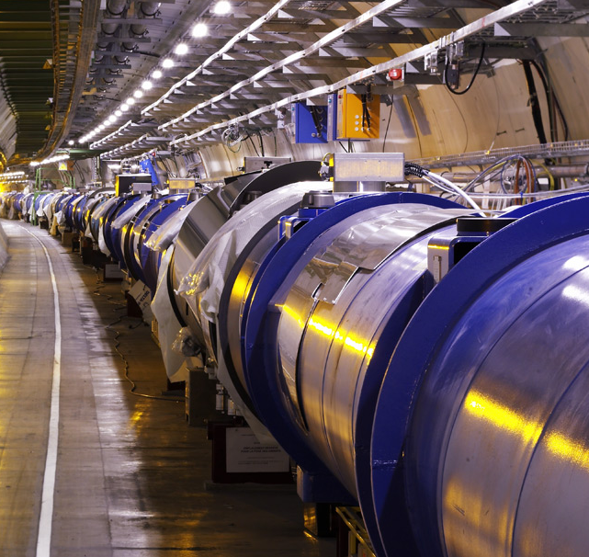
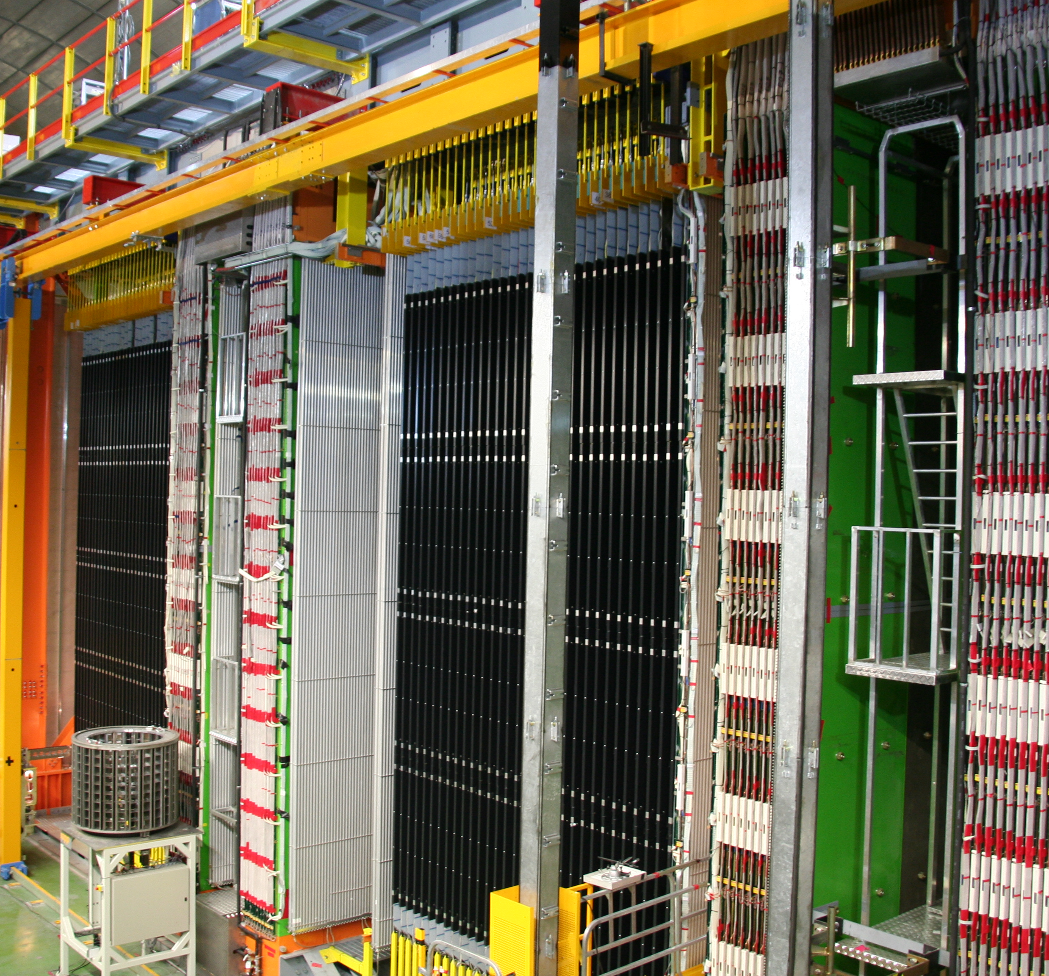
INTERNATIONAL COLLABORATIONS
3
Jyväskylä (Finland)
Fair / GSI (Germany)
JINR Dubna (Russia)
LHC, Isolde / Cern (Switzerland)
© Cern, Nasa, Opera, GSI, JINR Dubna, Profilmedia – Conception graphique : Anna Thibeau (IPNL)
Opera, Xenon / Gran Sasso Virgo (Italia)

Slide 15
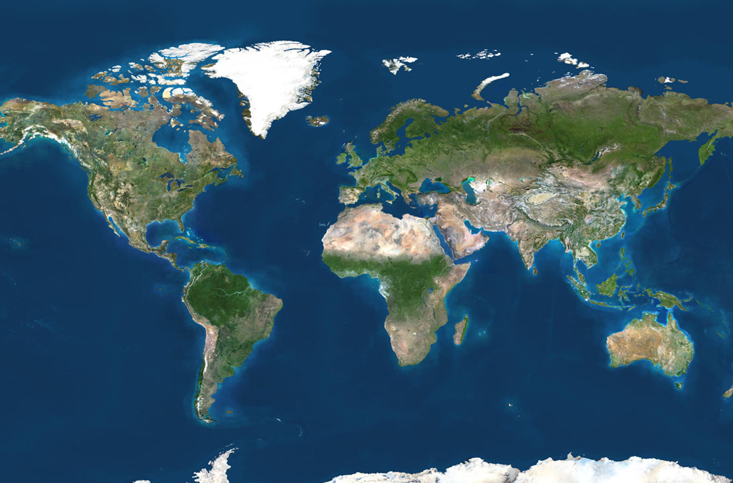
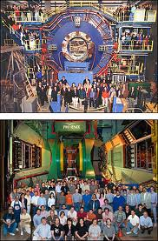
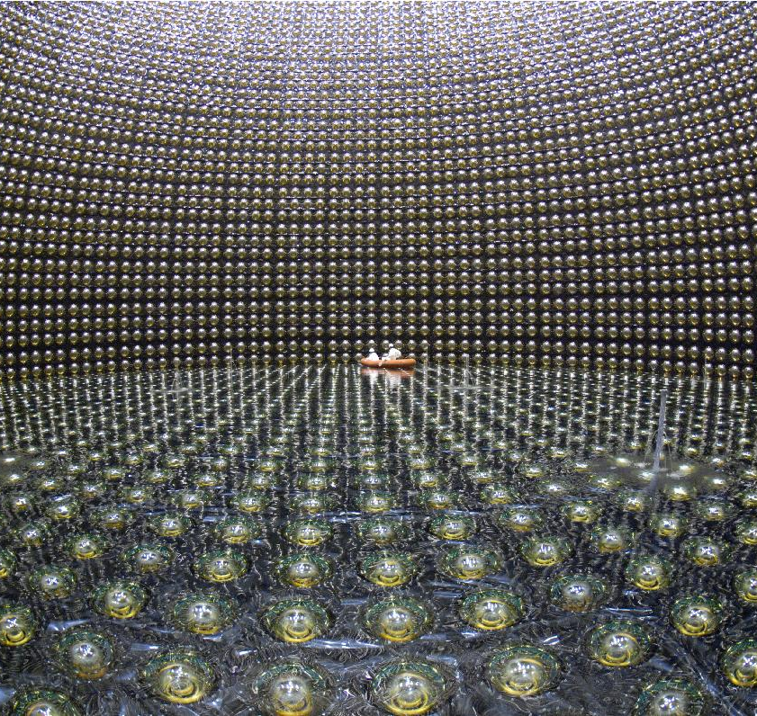
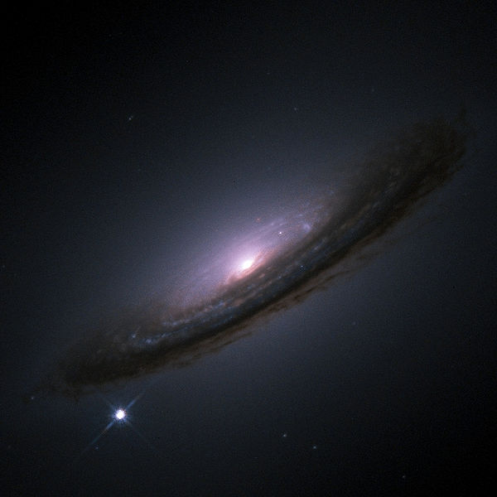
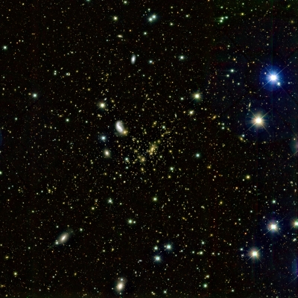
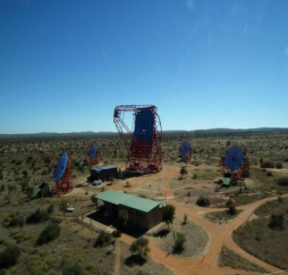
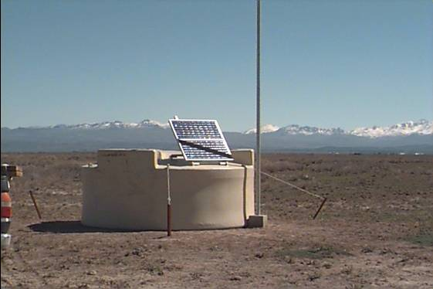
INTERNATIONAL COLLABORATIONS
3
DØ, CDF Tevatron
© Star/Phenix, Kamioka Observatory/ICRR/Université de Tokyo, Auger, Hess, ESA/Nasa, J.-P. Kneib (Observatoire Midi-Pyrénées) and R. Ellis (Caltech) – Conception graphique : Anna Thibeau (IPNL)
Star, Phenix Rhic, BNL
SNFactory (Hawaï)
Jlab
T2K / Jparc, Riken (Japan)
Hess (Namibia)
Fermi, AMS, Lisa Planck, Euclid
(Space)
LSST (Chili)
Auger (Argentina)
CTA

