Slide 1
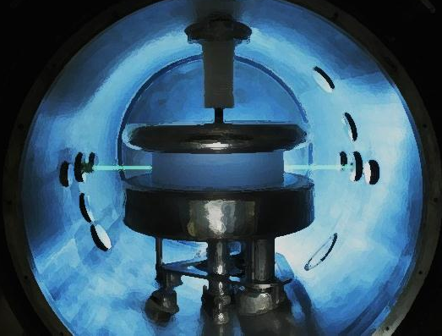
The nEDM experiment at PSI
1 Physics motivations
2 Status of the PSI UCN source
3 Status of the running EDM experiment
Systematics
Statistical sensitivity
Guillaume Pignol (LPSC Grenoble)
IN2P3 scientific council, 24/10/2013

Slide 2
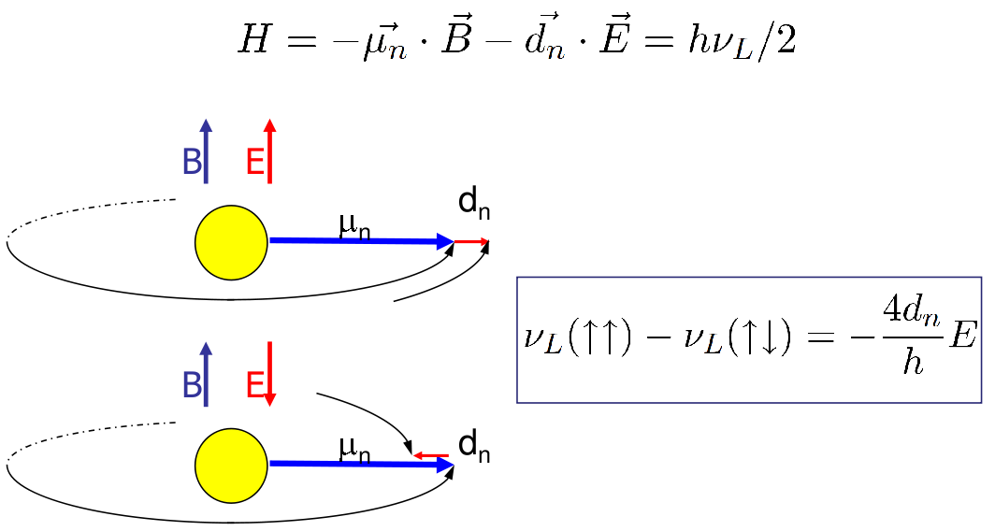
The nEDM
If nonzero, EDM violates T, thus CP

Slide 3
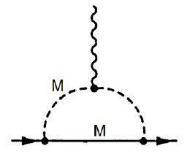
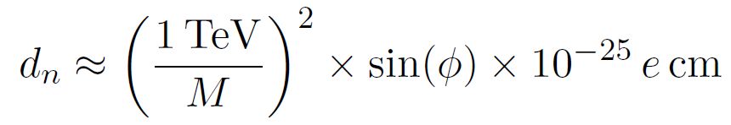
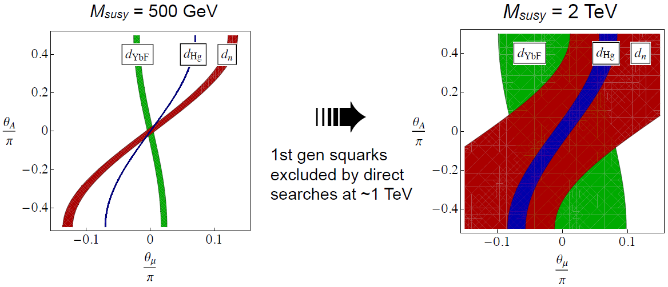
nEDM to probe generic BSM CP violation

Slide 4

nEDM to probe electroweak baryogenesis
Sakharov conditions
at electroweak phase transition
1 Departure from thermal equilibrium
requires BSM scalar sector
to get a strong first order transition.
May or may not be accessible at the LHC
2 CP violation
requires BSM physics,
accessible by the next generation of EDM experiments
3 Violation of B conservation
SM sphaleron transitions in the symmetric phase

Slide 5
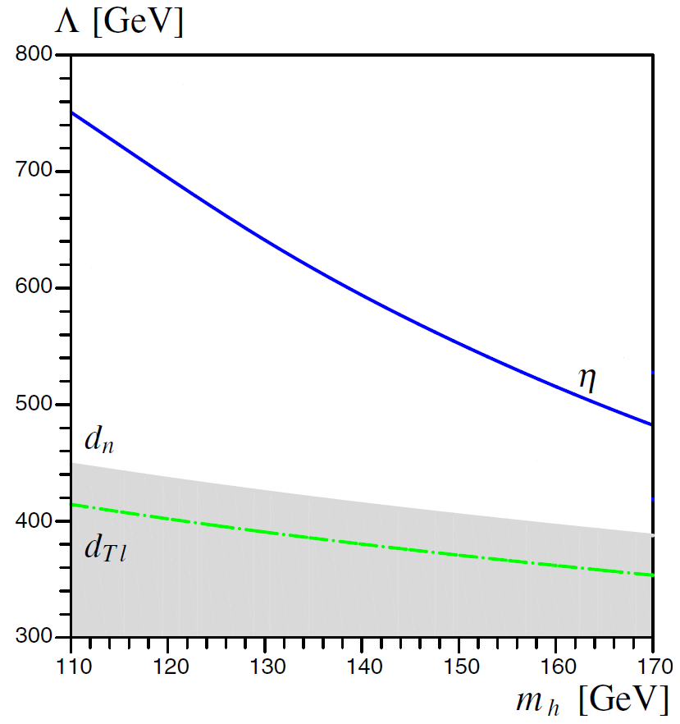


Minimal electroweak baryogenesis
Makes the phase transition strongly first order
CP violation
Prediction for 126 GeV Higgs
nEDM = 1.3 x 10⁻²⁶ e cm
(Current limit at 3 x 10⁻²⁶ e cm)

Slide 6
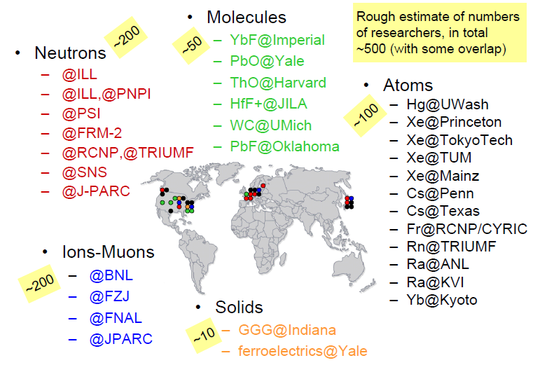
The quest for EDMs

Slide 7








The PSI EDM collaboration
Physikalisch Technische Bundesanstalt, Berlin
Laboratoire de Physique Corpusculaire, Caen
Institute of Physics, Jagiellonian University, Cracow
Henryk Niedwodniczanski Inst. Of Nucl. Physics, Cracow
Joint Institute of Nuclear Reasearch, Dubna
Département de physique, Université de Fribourg, Fribourg
Lab. de Physique Subatomique et de Cosmologie, Grenoble
Biomagnetisches Zentrum, Jena
Katholieke Universiteit, Leuven
Inst. für Kernchemie, Johannes-Gutenberg-Universität, Mainz
Centre de Spectrométrie Nucléaire et de Spectrométrie de Masse, Paris
Paul Scherrer Institut, Villigen
Eidgenössische Technische Hochschule, Zürich
M. Burghoff, S. Knappe-Grüneberg, A. Schnabel, J. Vogt
G. Ban, V. Hélaine, T. Lefort, Y. Lemiere, G. Quéméner
K. Bodek, M. Rawlik, G. Wyszynski, J. Zejma
A. Kozela
N. Khomutov
M. Kasprzak, H.C Koch, A. Weis, Z. Grujic
Y. Kermaïdic , G. Pignol, D. Rebreyend, B. Clément,
S. Afach
N. Severijns, P. Pataguppi
W. Heil
S. Roccia,
G. Bison , Z. Chowdhuri, M. Fertl, B. Lauss, S. komposch
D. Ries, P. Schmidt-Wellenburg, G. Zsigmond
B. Franke, K. Kirch, J. Krempel, F. Piegsa, D. Zhu
RED: PhD students, GREEN: spokespersons

Slide 8
The nEDM experiment at PSI
1 Physics motivations
2 Status of the PSI UCN source
3 Status of the running EDM experiment
Systematics
Statistical sensitivity

Slide 9
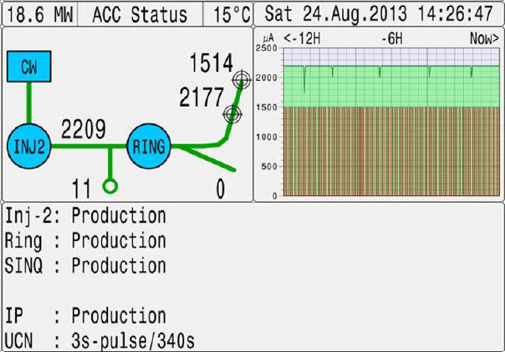
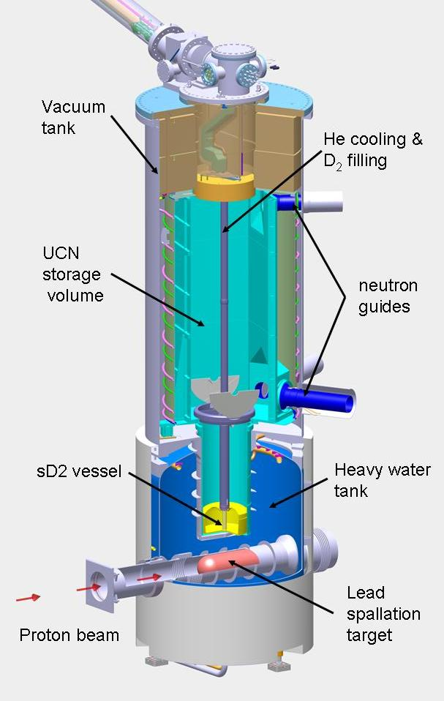
The PSI UCN source, availability
Paul Scherrer Institute, Zurich
600 MeV, 2.2 mA

Slide 10
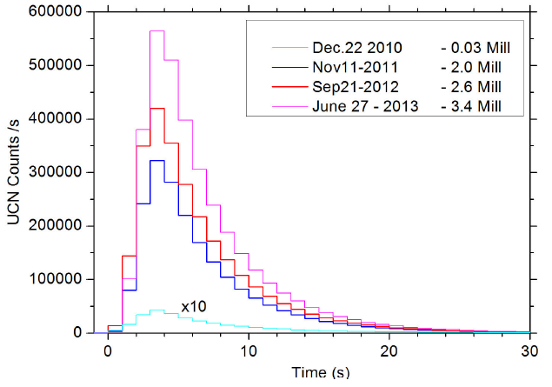
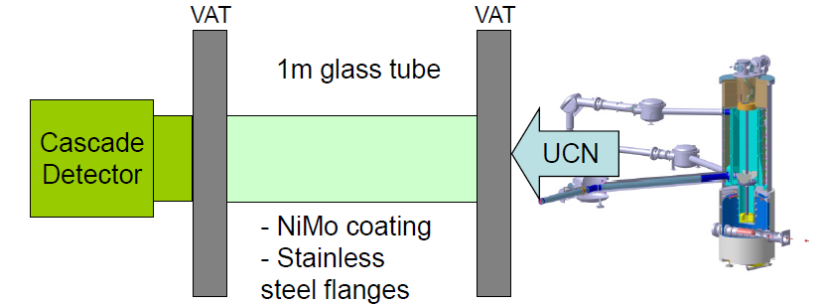
The PSI UCN source, intensity
UCN density measured at West1
23 UCN/cm³
Same vessel used at ILL PF2
4.7 UCN/cm³
Paul Scherrer Institute, Zurich
25 l volume

Slide 11
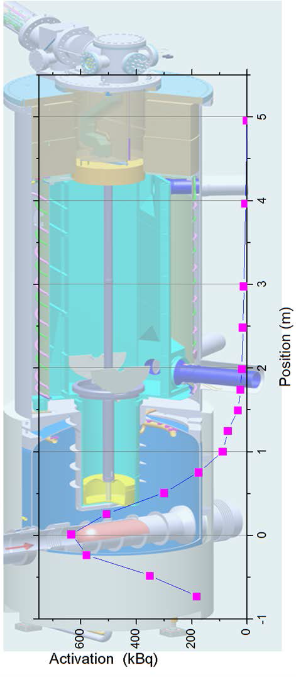
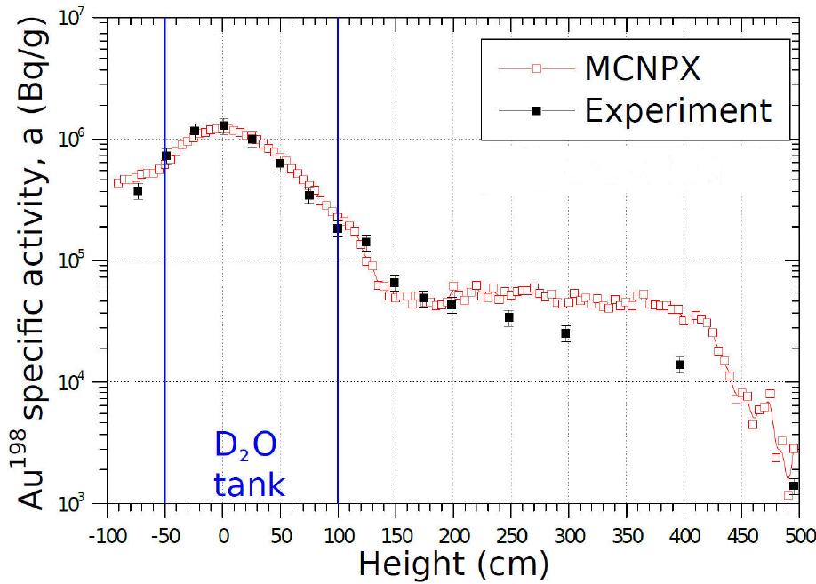
The PSI UCN source, recent progress
Paul Scherrer Institute, Zurich
Recently measured thermal neutron flux agrees with calculations.
Improvement by factor of ~15 in UCN output can still be gained, a goal actively pursued by the PSI group.

Slide 12
The nEDM experiment at PSI
1 Physics motivations
2 Status of the PSI UCN source
3 Status of the running EDM experiment
Systematics
Statistical sensitivity

Slide 13
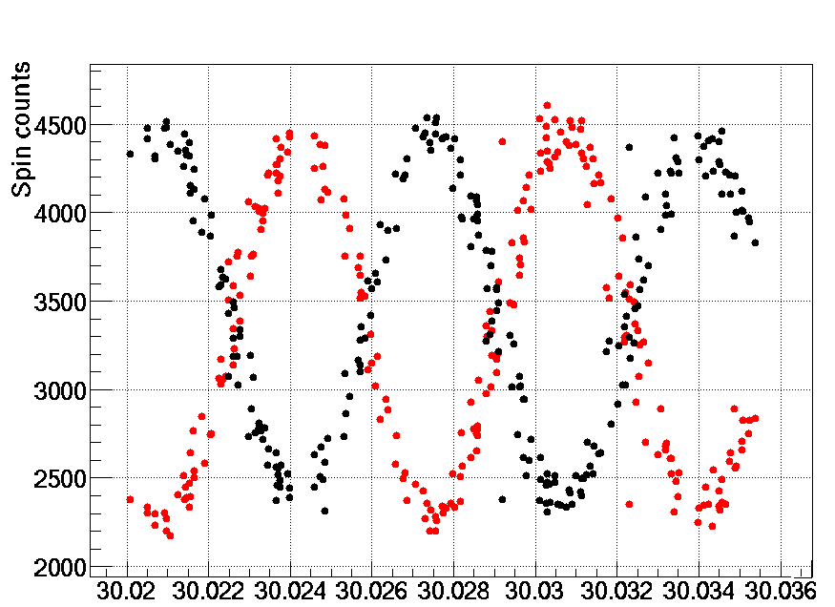
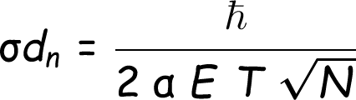

The Ramsey method
“Spin up” neutron...
Apply π/2 spin-flip pulse...
Applied pulse frequency [Hz]
Free precession...
T ~ 200 s
Second π/2 spin-flip pulse
polarization
electric field
counts
precession time

Slide 14
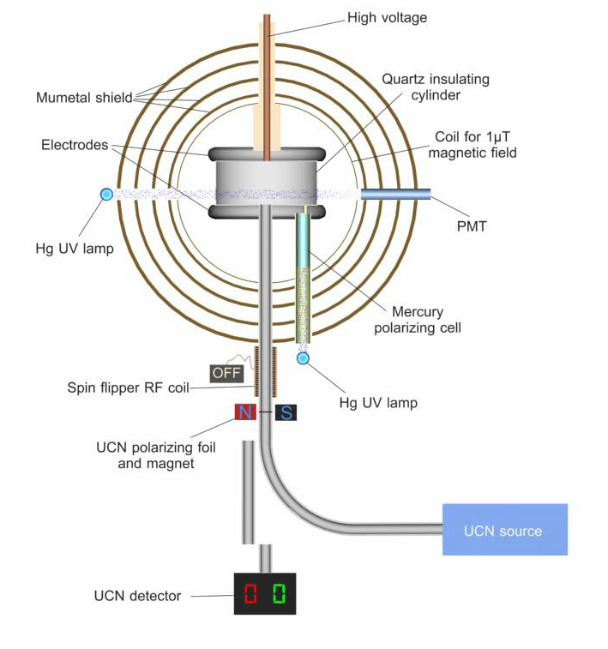
OILL spectrometer

Slide 15
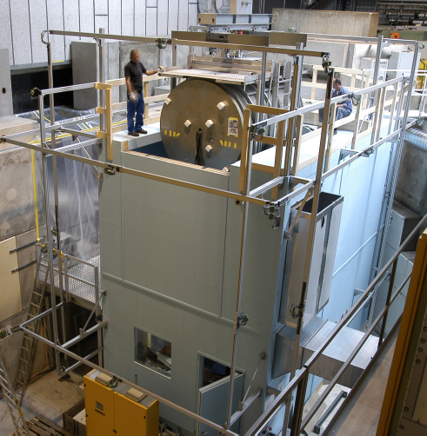
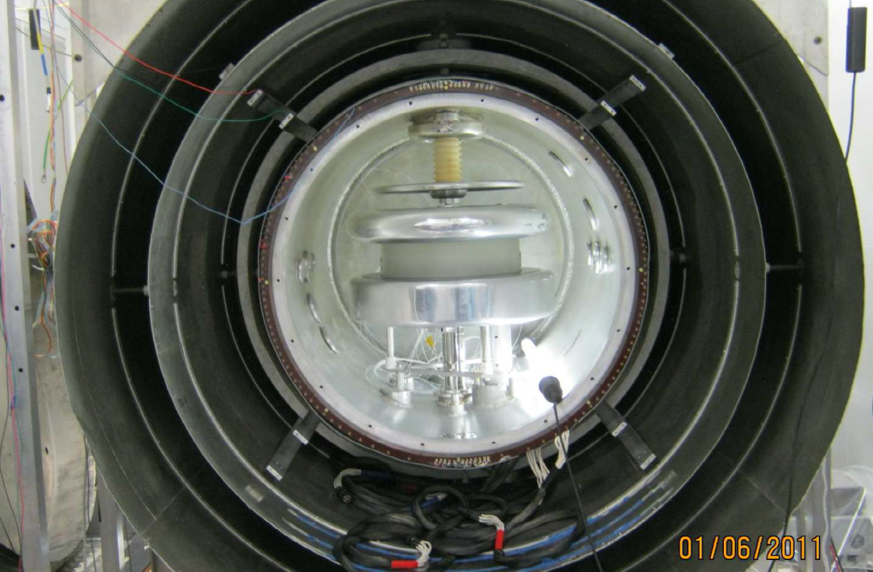
Current nEDM apparatus at PSI
Shielded magnetic environment
Homogeneity < 10⁻³
Time stability < 10⁻⁶
B₀ = 1 µT
Electric field 150 kV / 12 cm
OILL apparatus moved
from ILL to PSI in 2009

Slide 16
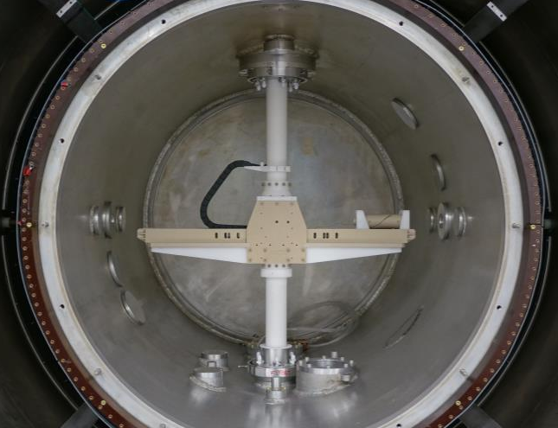
IN2P3 contribution
UCN detectors (Nanosc)
and electronics (FASTER)
Spin analysis system (USSA)
Magnetic field mapper
Central DAQ module
hardware+software
B₀ stable current source
Hg comagnetometer: optics
Parts of precession chamber
electrode, shutter

Slide 17
The nEDM experiment at PSI
1 Physics motivations
2 Status of the PSI UCN source
3 Status of the running EDM experiment
Systematics
Statistical sensitivity

Slide 18
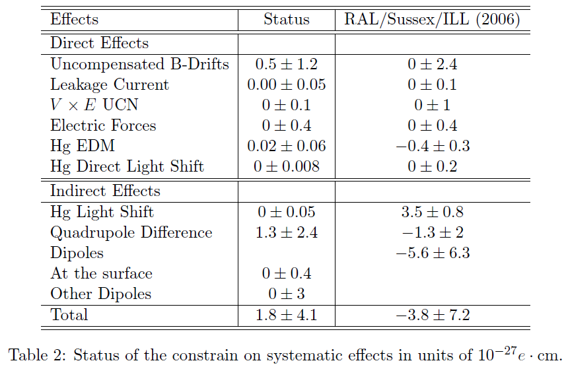
Systematic effects

Slide 19
Example: gravitational effect
Same precession chamber
UCN gaz
Mercury gaz
g
Center of gravity height difference is
R = fn / fHg depends on vertical gradients

Slide 20
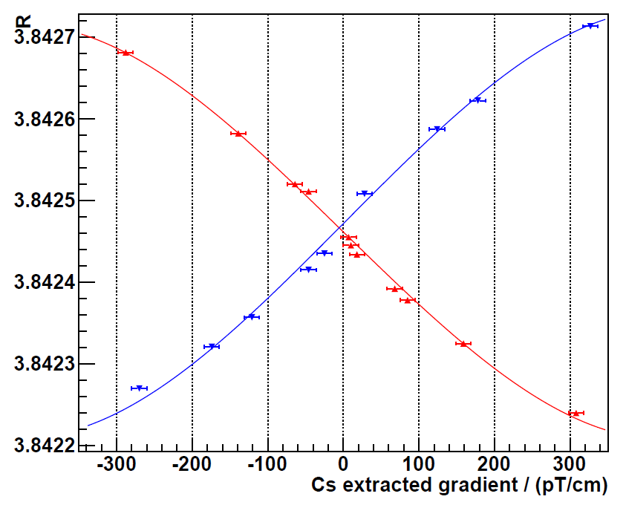
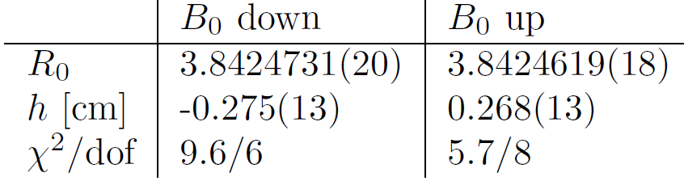
Gravitational effect

Slide 21
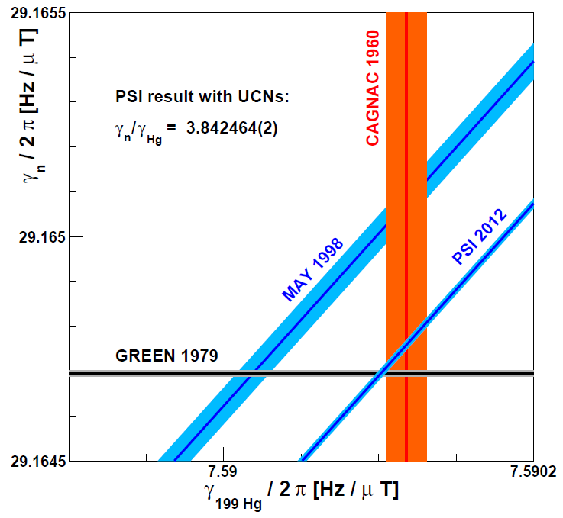
Interpretation: measurement of the neutron magnetic moment
PRELIMINARY

Slide 22
Publications, R&D and byproducts
Experimental study of 199Hg spin anti-relaxation coatings
Z. Chowdhuri et al, Applied Physics B (2013) 1.
Development of a multifunction module for the neutron electric dipole moment experiment at PSI
O. Bourrion, G. Pignol, D. Rebreyend, C. Vescovi, NIM A (2013) 278.
Electric dipole moment searches: reexamination of frequency shifts for particles in traps
G. Pignol, S. Roccia, Physical Review A 85 (2012) 042105.
First observation of trapped high-field seeking ultracold neutron spin states
M. Daum et al, Physics Letters B 704 (2011) 456.
New constraints on Lorentz invariance violation from the neutron electric dipole moment
I. Altarev et al, Europhysics Letters 92 (2010) 51001.
Test of Lorentz invariance with spin precession of ultracold neutrons
I. Altarev et al, Physical Review Letters 103 (2009) 081602.
Neutron to mirror-neutron oscillations in the presence of mirror magnetic fields
I. Altarev et al, Physical Review D 80 (2009) 032003.
Direct Experimental Limit on Neutron–Mirror-Neutron Oscillations
G. Ban et al, Physical Review Letters 99 (2007) 161603.

Slide 23
The nEDM experiment at PSI
1 Physics motivations
2 Status of the PSI UCN source
3 Status of the running EDM experiment
Systematics
Statistical sensitivity

Slide 24
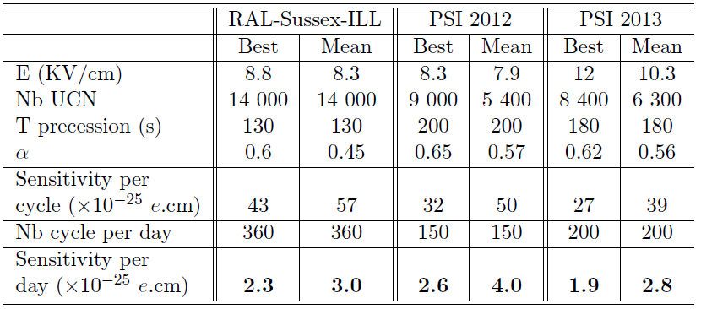
Statistical sensitivity

Slide 25
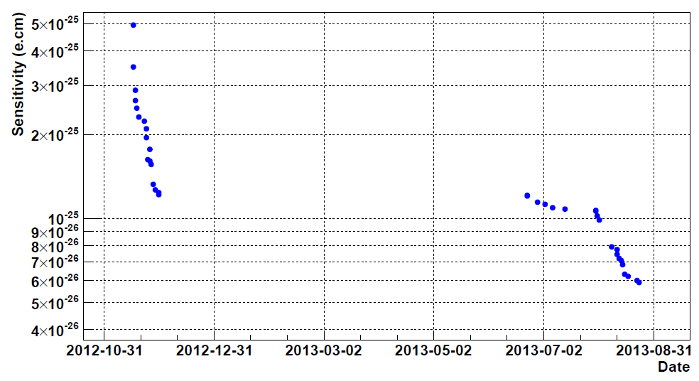
Statistical sensitivity
Winter shutdown
Tests UCN source

Slide 26
Conclusions
5000 EDM cycles recorded with OILL@PSI in 2012-2013
Statistical power at 6 x 10⁻²⁶ e cm
Systematics controlled at 0.4 x 10⁻²⁶ e cm
-> a great laboratory to study n2EDM systematics
Improving the previous limit with OILL is possible provided
3 more years of data taking
Increased availability of the source for EDM
Improved statistics (better UCN source and/or UCN transport)

Slide 27
The nEDM experiment at PSI
BACKUP SLIDES

Slide 28
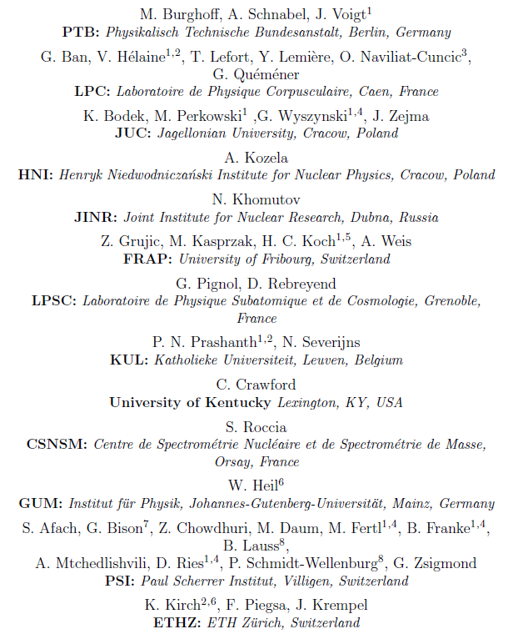
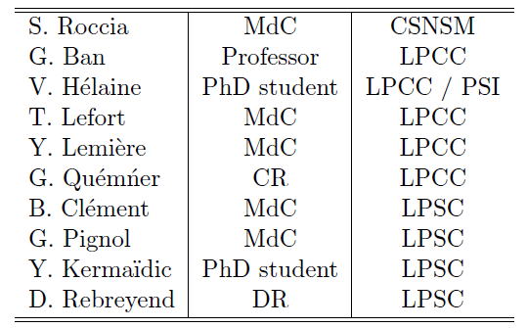
Collaboration list

Slide 29
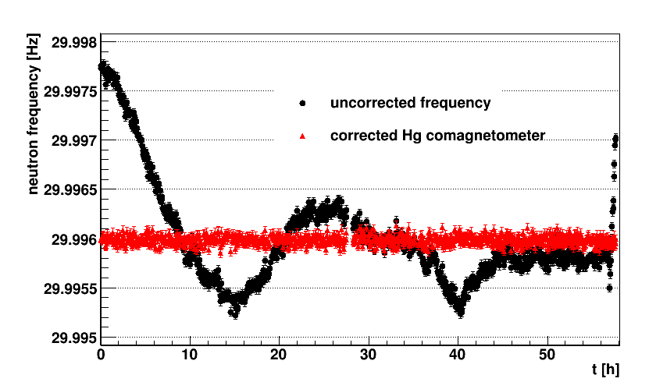
Le magnétomètre mercure
Le Comagnétomètre corrige les fluctuations du champ magnétique

Slide 30


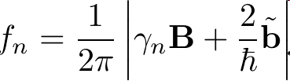

Test de l’invariance de Lorentz
Interaction potential
Earth rotation axis
A spin up (at ILL)
Neutron spin precession
Daily modulation
Cosmic axial field b

Slide 31
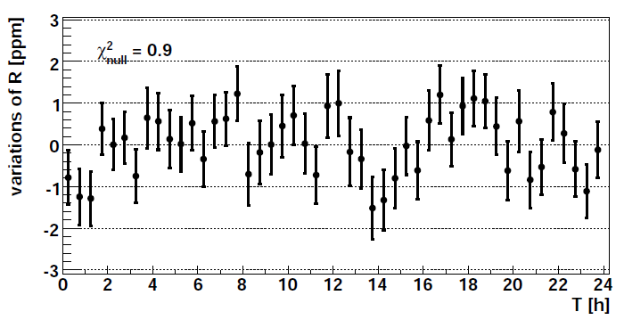

Limite sur la modulation a 24h
April 2008, 5 days of data.
December 2008, 6 days of data.
Altarev et al, Phys. Rev. Lett 103 (2009)

Slide 32
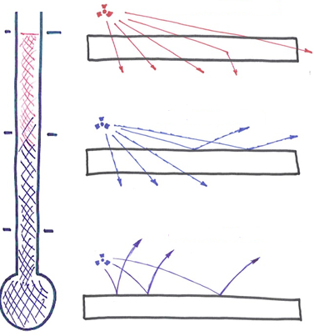

Ultracold neutrons (UCN)
Thermal neutrons
UCNs feel gravity
GRANIT to measure the bouncing quantum states
Cold neutrons
Ultracold neutrons
UCNs can be stored in bottles for very long times (1000 s)
precision measurement of the neutron electric dipole moment (nEDM)
Neutrons with energy < 100 neV, or velocity < 5 m/s
are reflected by material walls

Slide 33

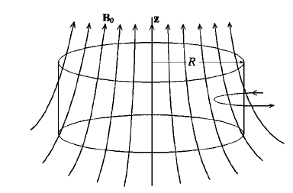
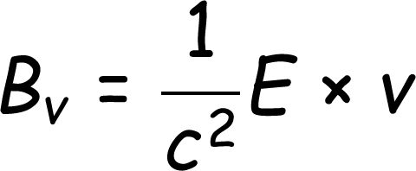
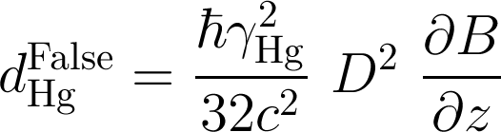
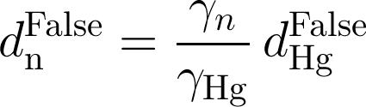
Geometric phase of mercury
Motional (transverse) field
Magnetic transverse field
Frequency shift correlated with electric field
False EDM for Mercury (fast regime of GPE)
Pendlebury et al,
PRA 70 032102 (2004)
False neutron EDM when using Hg comagnetometer
Indirect systematic effect

Slide 34
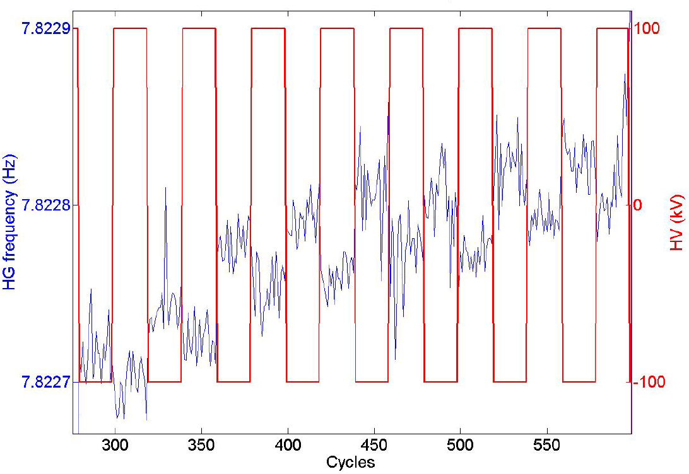
Dedicated measurement with Hg magnetometer
Apply a large magnetic gradient with trimcoils
Apply an electric field of 100 kV/12 cm, with polarity reversed every 20 cycles
Take data for 20 days with different gradient configurations
A clear correlation between Hg frequency and the electric field in the presence of a magnetic gradient.

Slide 35
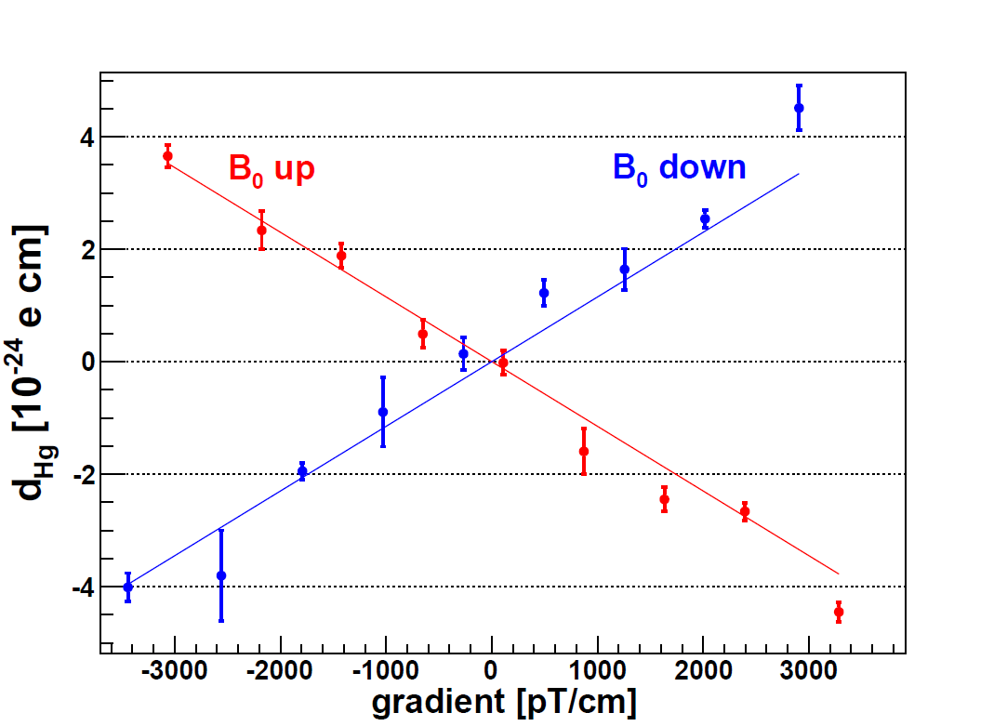
Dedicated measurement with Hg magnetometer
Final result
theory
Magnetic gradient extracted from fluxgates maps

Slide 36
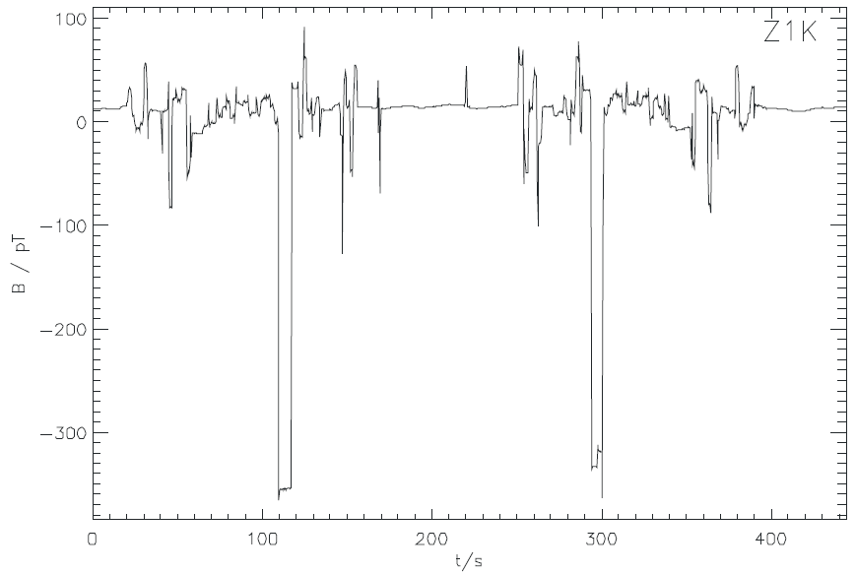



Impurities on the electrode
Scan of the Sussex bottom electrode
At PTB in Nov. 2011
Groove insulating ring
Approximate dipole position
We would then quote a systematic effect
Approximate dipole strength

Slide 37

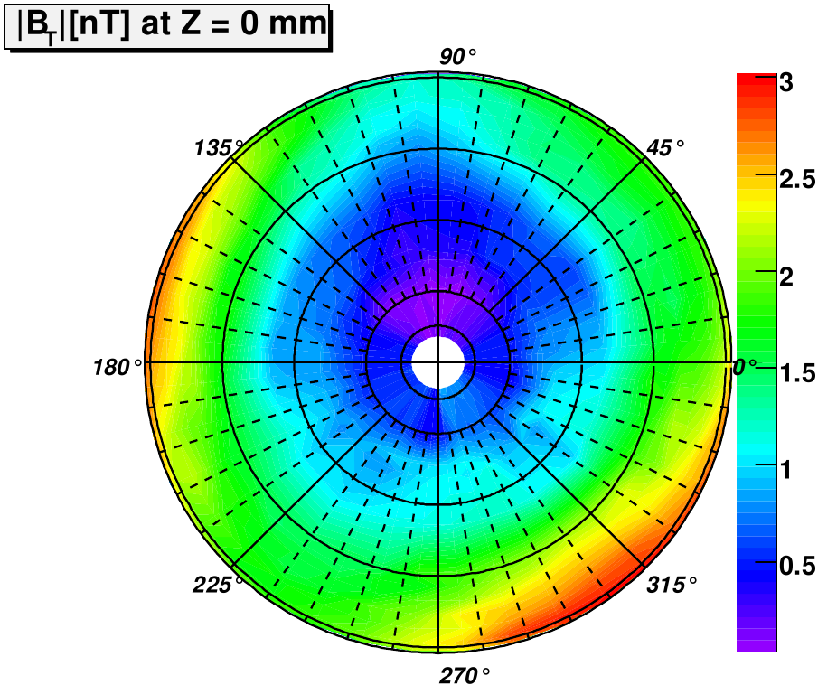
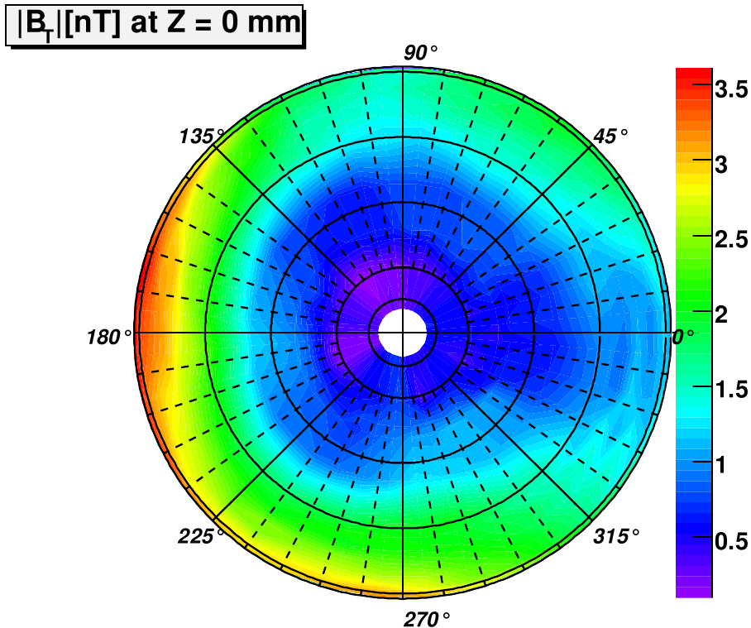
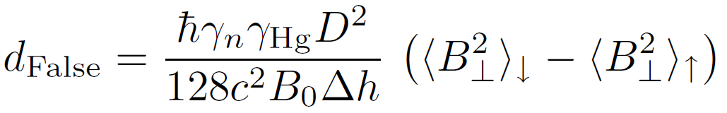
Transverse field measured with fluxgate maps

