Slide 1


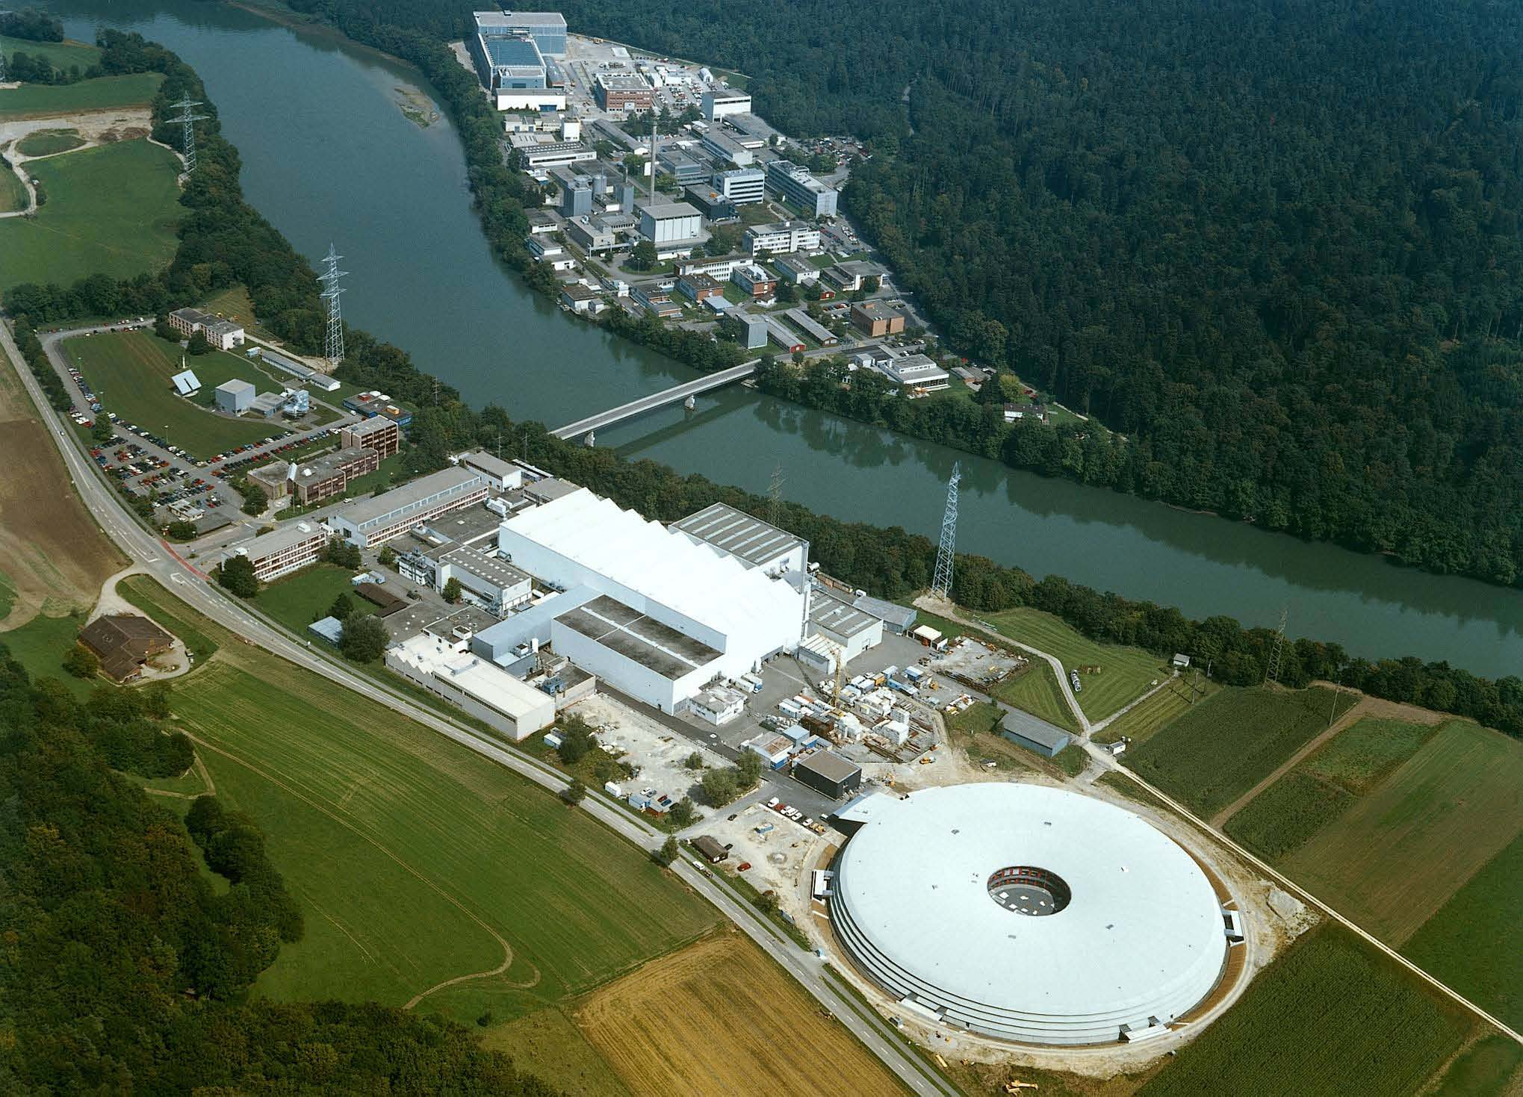
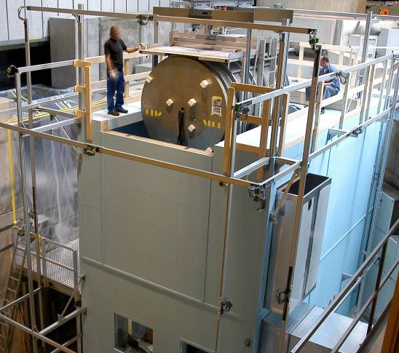
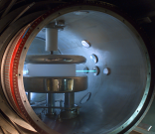

Laboratoire de Physique Corpusculaire - Caen
Conseil scientifique - in2p3
(24.10.2013)
The measurement of the neutron electric dipole moment
The n2EDM project
CSNSM, CNRS, IN2P3, Université Paris sud
LPC Caen, CNRS, IN2P3, ENSICAEN, Université de Caen
LPSC, Grenoble, CNRS, IN2P3, Université Joseph Fourier, INPG
G. Ban, B. Clément, T. Lefort, Y. Lemière, G. Pignol, G. Quéméner,
D. Rebreyend, S. Roccia
PhD students: V. Hélaine, Y. Kermaïdic
Technical departments
(Mechanics, Electronics, Detection, Instrumentation, Computing)
Conseil scientifique in2p3 24.10 .2013
Lefort Thomas – Interactions fondamentales – LPC Caen

Slide 2
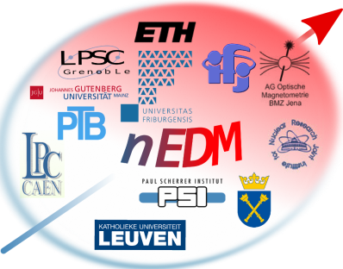





The n2EDM collaboration
Physikalisch Technische Bundesanstalt, Berlin
Laboratoire de Physique Corpusculaire, Caen
Institute of Physics, Jagiellonian University, Cracow
Henryk Niedwodniczanski Inst. Of Nucl. Physics, Cracow
Joint Institute of Nuclear Reasearch, Dubna
Département de physique, Université de Fribourg, Fribourg
Lab. de Physique Subatomique et de Cosmologie, Grenoble
Katholieke Universiteit, Leuven
Inst. für Kernchemie, Johannes-Gutenberg-Universität, Mainz
Centre de Spectrométrie Nucléaire et de Spectrométrie de Masse, Paris
Paul Scherrer Institut, Villigen
Eidgenössische Technische Hochschule, Zürich
M. Burghoff, S. Knappe-Grüneberg, A. Schnabel, J. Vogt
G. Ban, V. Hélaine¹, T. Lefort, Y. Lemiere, G. Quéméner
K. Bodek, M. Rawlik, G. Wyszynski³, J. Zejma
A. Kozela
N. Khomutov
M. Kasprzak, H.C Koch, A. Weis, Z. Grujic
Y. Kermaîdic , G. Pignol, D. Rebreyend, B. Clément,
N. Severijns, P. Pataguppi
W. Heil
S. Roccia,
S. Afach, G. Bison , Z. Chowdhuri, M. Fertl³, B. Lauss, S. komposch
D. Ries, P. Schmidt-Wellenburg, G. Zsigmond
B. Franke, K. Kirch¹, J. Krempel, F. Piegsa, D. Zhu
also at: ¹Paul Scherrer Institut, ²PNPI Gatchina, ³Eidgenössische Technische Hochschule
Conseil scientifique in2p3 24.10 .2013
Lefort Thomas – Interactions fondamentales – LPC Caen
Notes:
I would like to thank you all for your interest and all these colleagues for their excellent work!
Thank you very much.

Slide 3
Outline
  International context
  General concept
  n2EDM spectrometer
  Systematic effect
  Statistical sensitivity
  French laboratories involvement
  Planning, Man power, Budget
Conseil scientifique in2p3 24.10 .2013
Lefort Thomas – Interactions fondamentales – LPC Caen

Slide 4
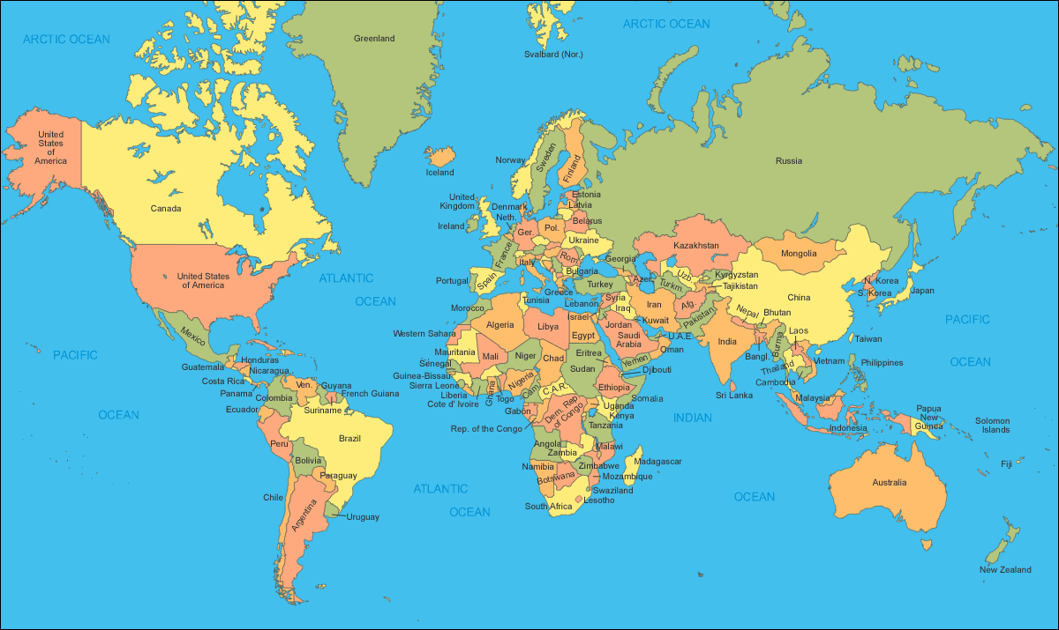
International context
Six nEDM projects worldwide:
- Three running experiments: PSI, ILL (2)
- Three planned experiments: FRMII, SNS, RCNP/TRIUMPF
Goal : ≤ 10⁻²⁷ e.cm
PNPI
TRIUMF
ILL
FRMII
PSI
SNS
RCNP
UCN sources not built yet except for CryoEDM(ILL) and PSI
Conseil scientifique in2p3 24.10 .2013
Lefort Thomas – Interactions fondamentales – LPC Caen

Slide 5
The measurement principle
Neutron Larmor frequency shift induced by electric field
Conseil scientifique in2p3 24.10 .2013
Lefort Thomas – Interactions fondamentales

Slide 6
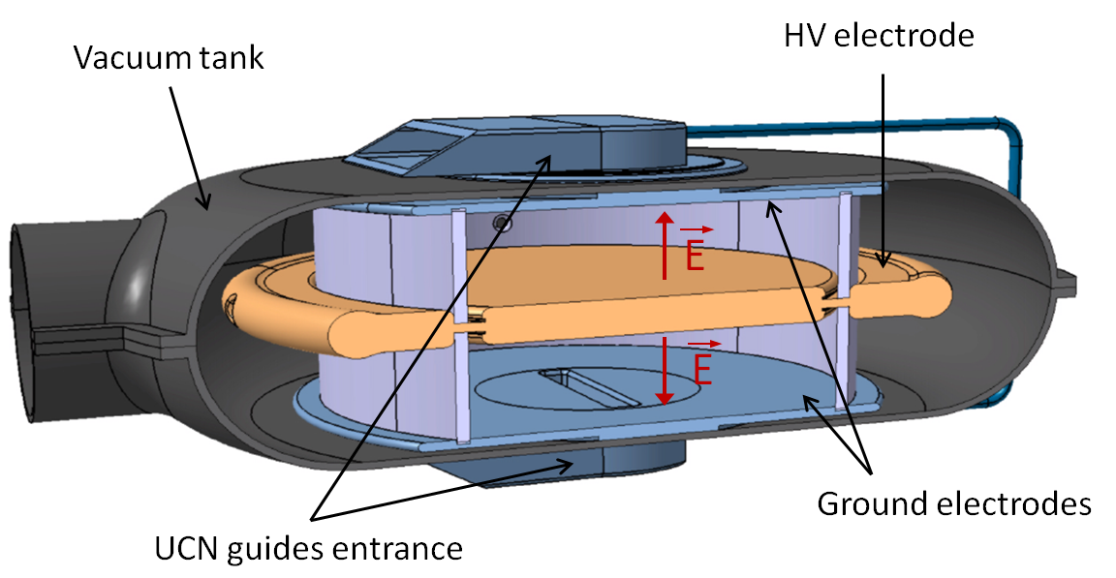
n2EDM: general concept
  Simultaneous measurement of the neutron frequency for both field configurations
  → means: two chambers with opposite electric field direction
B₀
  → independent of B field drift for parallel and anti-parallel (E,B)
Conseil scientifique in2p3 24.10 .2013
Lefort Thomas – Interactions fondamentales – LPC Caen

Slide 7
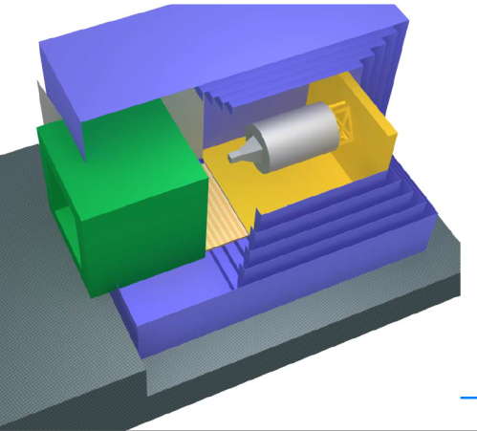
Magnetic field control
  Magnetic field stability and homogeneity (B₀ = 1 µT)
  - New passive cubic multilayer shield (PSI)
  5 layers, shielding factor ≈ 10⁵, shield delivered in 2015
  - Coils system (LPC/Kentucky)
  new technique, field homogeneity 10⁻⁵, no external field
  - Stabilized B₀ current source (LPSC)
  B₀ drift during precession < 10⁻⁷ (100 fT)
  - Active surrounding field compensation (ETH/Cr)
  reduce external field fluctuations and inhomogeneties
  - Shield degaussing (PTB/PSI)
  residual field < 100 pT
  + electrodes degaussing @ PTB, active 3D field stabilization, thermohouse (built)
Movable vacuum tank
Movable coils system
Fixed multilayer passive
magnetic shield
Conseil scientifique in2p3 24.10 .2013
Lefort Thomas – Interactions fondamentales – LPC Caen

Slide 8
Magnetic field control
  Magnetic field stability and homogeneity (B₀ = 1 µT)
  - New passive cubic multilayer shield (PSI)
  5 layers, shielding factor ≈ 10⁵, shield delivered in 2015
  - Coils system (LPC/Kentucky)
  new technique, field homogeneity 10⁻⁵, no external field
  - Stabilized B₀ current source (LPSC)
  B₀ drift during precession < 10⁻⁷ (100 fT)
  - Active surrounding field compensation (ETH/Crakow)
  reduce external field fluctuations and inhomogeneties
  - Shield degaussing (PTB,PSI)
  residual field < 100 pT
  + electrodes degaussing @ PTB, active 3D field stabilization, thermohouse (built)
0.5 m
  Homogeneity < 10⁻⁵ (10 pT)
  Gradient < 1 pT/cm
  Stability during precession < 10⁻⁷ (100 fT)
Conseil scientifique in2p3 24.10 .2013
Lefort Thomas – Interactions fondamentales – LPC Caen

Slide 9
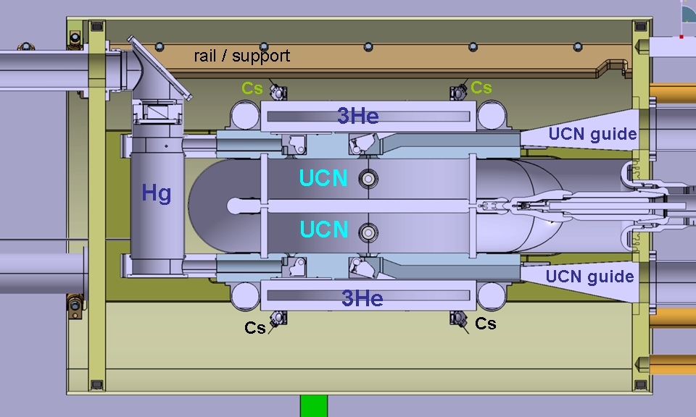
Magnetic field monitoring
  Three magnetometers are going to be used:
  - scalar Hg comagnetometer: field within the precession chambers
  - scalar ³He magnetometer: field gradient
  - vector Cs magnetometers: field components (transverse)
Hg
Hg
Conseil scientifique in2p3 24.10 .2013
Lefort Thomas – Interactions fondamentales – LPC Caen

Slide 10
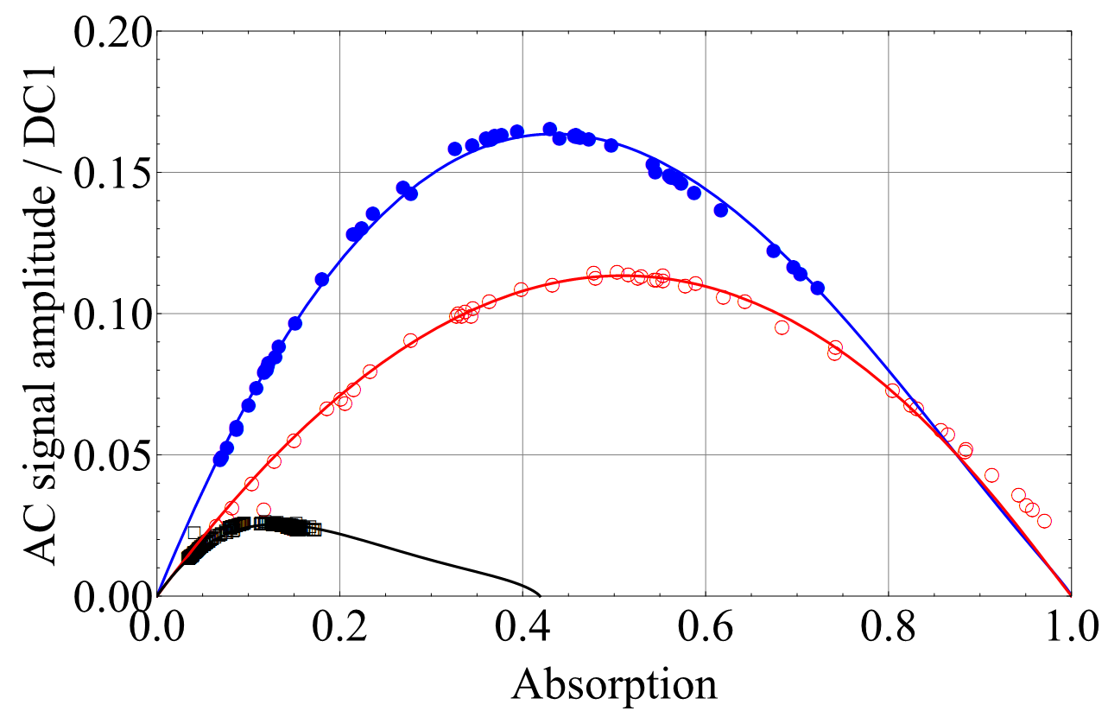
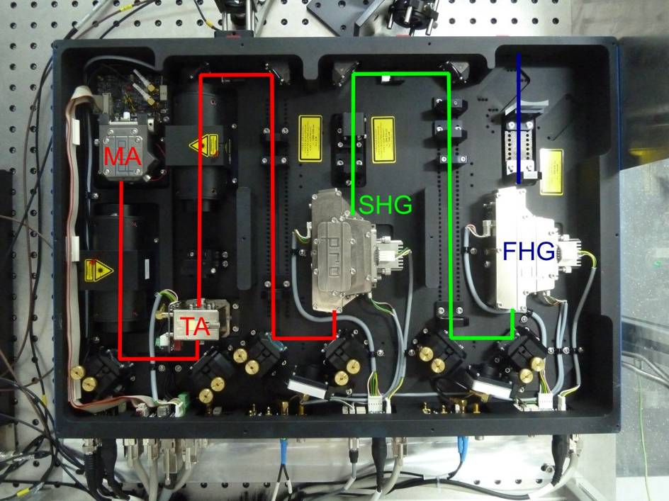
Magnetic field monitoring
  Hg comagnetometer with laser readout (instead of lamp readout)
  - field measurement at UCN location (foreseen sensitivity < 50 fT)
  - gradient measurement (foreseen sensitivity < fT/cm)
  - but sensitive to Geometrical Phase Effect (GPE)
laser
laser
lamp
Hg
Hg
Conseil scientifique in2p3 24.10 .2013
Lefort Thomas – Interactions fondamentales – LPC Caen

Slide 11
Magnetic field monitoring
  External magnetometers: Cs + ³He (free from GPE but further away from UCN location)
  - ³He magnetometers (Cs readout): gradient measurement (foreseen sensitivity : < 10 fT/cm)
  - vector Cs magnetometers: field components (transverse !)
Hg
Hg
Conseil scientifique in2p3 24.10 .2013
Lefort Thomas – Interactions fondamentales – LPC Caen

Slide 12
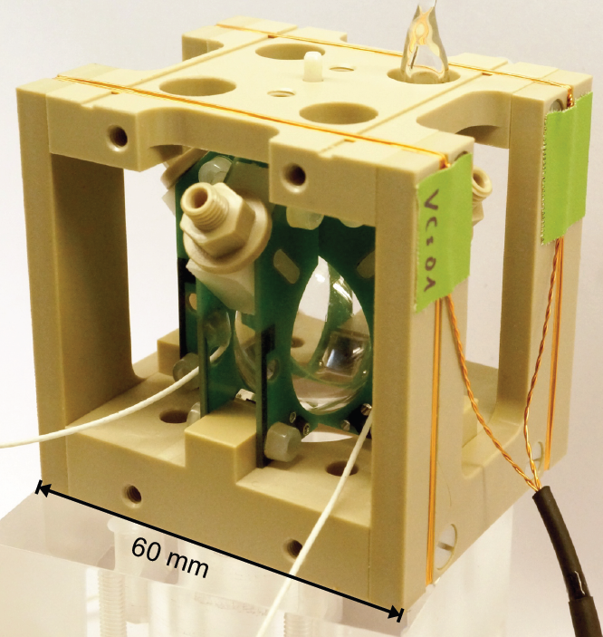
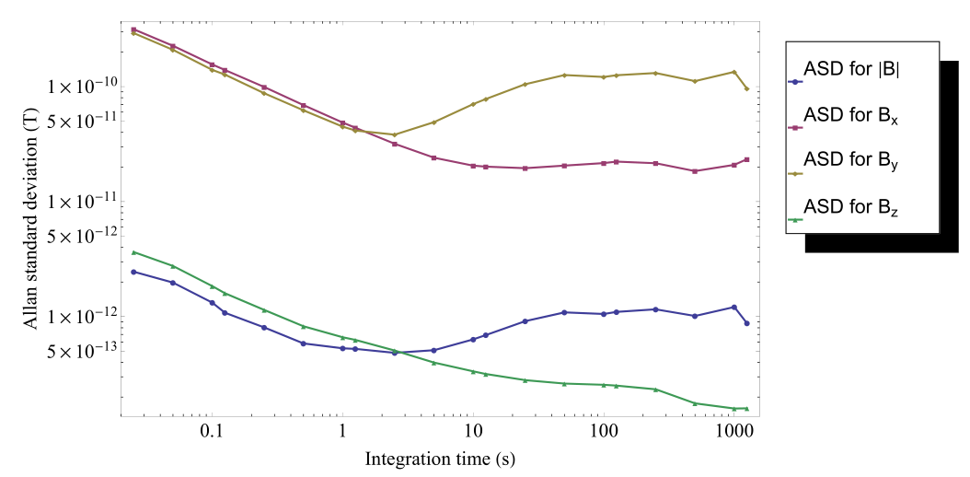
Magnetic field monitoring
  External magnetometers: Cs
  - Vertical component and field modulus @ 100 s: few 100 fT
  - Transverse component @ 100 s: few 10 pT
  Mechanical stability has to be improved: 400 pT for transverse components
Conseil scientifique in2p3 24.10 .2013
Lefort Thomas – Interactions fondamentales – LPC Caen

Slide 13
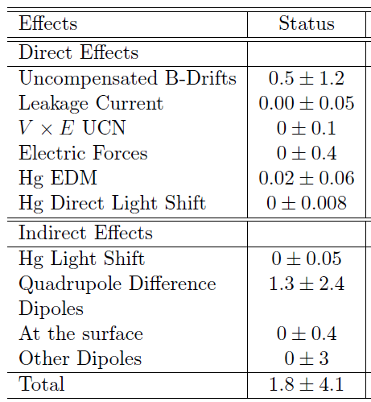
Systematic effects control
Homogeneity and stability
Field homogeneity: < 10⁻⁵
Field stability : 10⁻⁷
Online field monitoring
Comagnetometer (Hg)
External magnetometers (Cs + ³He)
Vertical gradient
Field components (transverse)
+ offline 3D field maps
Global systematic error < 10⁻²⁷ e.cm
Conseil scientifique in2p3 24.10 .2013
Lefort Thomas – Interactions fondamentales – LPC Caen

Slide 14
Expected statistical sensitivity
→ work on improving (α, E,T,N) parameters
Parameter | Improvement factor | Comment
Neutrons number N | 5 | Spectrometer – source height (x 3) Double precession chambers (x 1.5)
Electric field E | 1.3 | New electrodes geometry
Visibility α | 1.25 | Larger T2 (field homogeneity)
Precession time T | ? | Coating investigation (Diamond)
Statistical sensitivity | 8 | Based on the current source performances
Foreseen sensitivity
4.10⁻²⁶ e.cm / day
2.10⁻²⁷ e.cm / 4 years
Conseil scientifique in2p3 24.10 .2013
Lefort Thomas – Interactions fondamentales – LPC Caen

Slide 15
Tasks distribution
ITEM | TASK RESPONSIBLE
UCN Source | PSI
New thermohouse (completed) | PSI
Passive magnetic shield | ETH/ PSI
B0, correcting, RF coils system | Caen (Design, prototype) / Kentucky/ ETH/ PSI/ Grenoble (Source)
UCN precession chamber + guides | Mainz/ PSI
Surrounding field compensation | ETH/ Cracow
Degaussing | PTB/ PSI
Vacuum tank + vacuum system | Leuven+ Caen (Design, construction)
High voltage | PSI
Magnetometry (Hg, Cs, ³He) | Fribourg/ Mainz/ Jena/ Grenoble (Hg)/ PTB/ PSI
Setup / experiment support | PSI+ Caen (Design, construction)
Detector+ Spin Analysis | Caen
DAQ | Cracov/ Caen (Front End-Faster)
+ French group: data analysis + systematic effects studies
+ n2EDM design (simulation, modeling)
Conseil scientifique in2p3 24.10 .2013
Lefort Thomas – Interactions fondamentales – LPC Caen

Slide 16
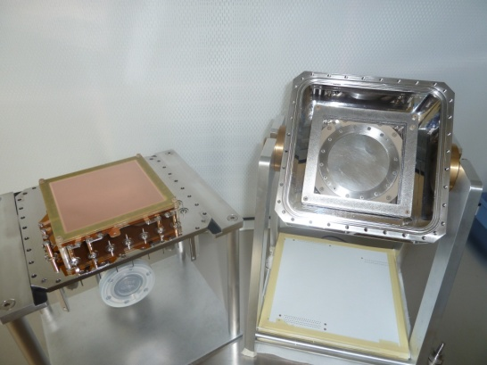
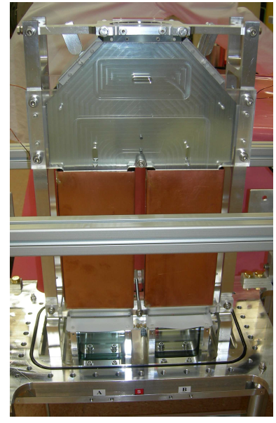
French laboratories involvement
n + ³He → ¹H + ³H (+ 0.77 MeV)
Detection: development of a new fast ³He gas detector
- lower gamma sensitivity, larger detection efficiency
- ability to handle large rate: up to few 10⁵ UCN/s
Two sealed versions are considered : HeGEM vs HeScint
Combined with FASTER acquisition system
Spin analysis and guiding fields:
- holding fields along UCN path (E. Pierre thesis, 2012)
- simultaneous measurement of UCN polarization (V. Hélaine,)
Prospective: diamond coating for the apparatus inner walls
major improvement if successful (test in 2014)
n2EDM requirements:
- 2 simultaneous spin analysers + 4 detectors
Conseil scientifique in2p3 24.10 .2013
Lefort Thomas – Interactions fondamentales – LPC Caen

Slide 17
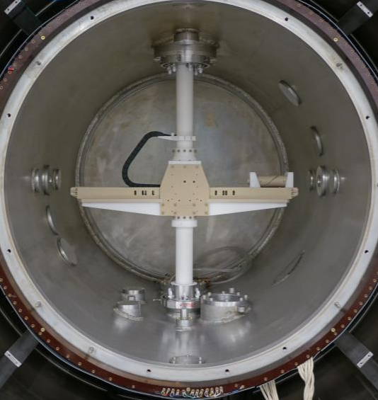
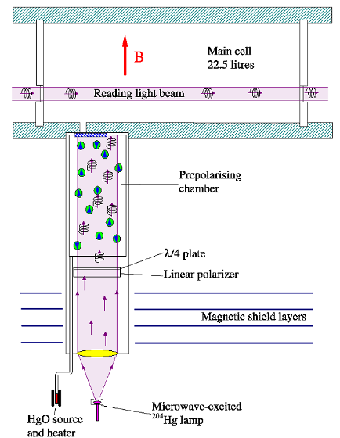
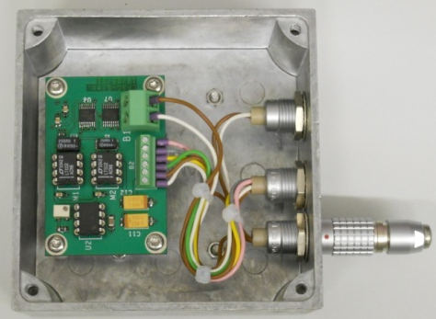
French laboratories involvement
DISCO prototype
Mapper – winter 2013
Coil design: new technique + double layers
→ field uniformity < 10⁻⁵ (LPC/Kentucky)
Magnetic field mapping:
→ 3D field map within vacuum chamber
Stable B₀ current source (Y. Kermaïdic thesis):
  → stability during precession < 10⁻⁷ (100 fT)
Hg comagnetometer (Y. Kermaïdic thesis):
→ Hg depolarisation vs electric field reversal
→ Buffer gas: GPE suppression
B0 current source
Conseil scientifique in2p3 24.10 .2013
Lefort Thomas – Interactions fondamentales – LPC Caen

Slide 18
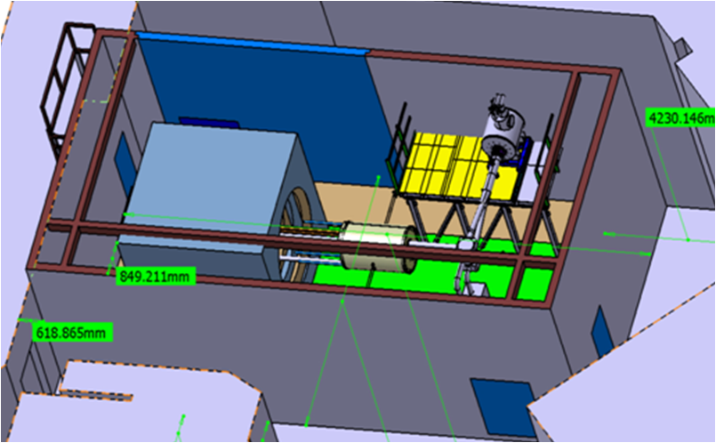
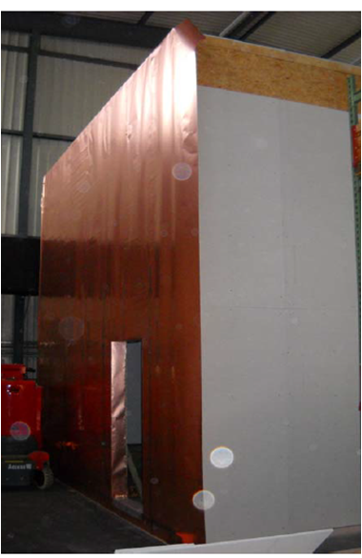
Planning
Global planning
2014-2017 : construction
2018 : commissioning
2018-2022 : data taking
2013: thermohouse built + shield WTO call
2015: magnetic shield delivered to PSI
2014-15:
- overall mechanical design
- detectors prototype, diamond coating
- Hg test bench
2015-17:
- mechanical support, vacuum chamber, coils
- UCN guides and switch, HV feed-through
- storage chamber, corona ring
2017-2018 :
- test, optimization, assembling
Conseil scientifique in2p3 24.10 .2013
Lefort Thomas – Interactions fondamentales – LPC Caen

Slide 19
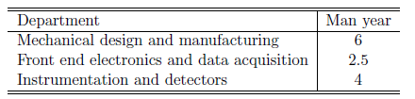
Manpower involvement
LPC, Caen
Gilles Ban (Prof. ENSI - 50%)
Victor Hélaine (PhD, 2011-14)
Thomas Lefort (MdC UCBN - 100%)
Yves Lemière (MdC UCBN - 50%)
Gilles Quéméner (CR - 35%)
LPSC, Grenoble
Benoit Clément (MdC – 50%)
Y. Kermaïdic (PhD, 2013 -16)
Guillaume Pignol (MdC - 40%)
Dominique Rebreyend (DR - 75 %)
CSNSM, Paris
Stéphanie Roccia (MdC - 50%)
LPSC + CSNSM + LPC Physicist: 2.8 ETP
for 2014 - 2018
PhD students: keep on co-advised PhD students with share funding (3 with nEDM)
Current request : post docs @ LPC
Conseil scientifique in2p3 24.10 .2013
Lefort Thomas – Interactions fondamentales – LPC Caen

Slide 20
Overall budget
ITEM | COST (k€) | TASK RESPONSIBLE | FUNDED
UCN Source | A lot… | PSI | X
New thermohouse (completed) | 260 | PSI | X
Passive magnetic shield | 2'000 | ETH/ PSI | X
B0, correcting, RF coils system | 400 | Caen (Design, prototype) / Kentucky/ ETH/ PSI/Grenoble (Source)
UCN precession chamber + guides | 600 | Mainz/ PSI
Surrounding field compensation | 200 | ETH/ Cracow
De-Gaussing | 100 | PTB/ PSI
Vacuum tank + vacuum system | 250 | Leuven+ Caen (Design, construction)
High voltage | 100 | PSI
Magnetometry (Hg, Cs, ³He) | 700 | Fribourg/ Mainz/ Jena/Grenoble (Hg)/ PTB/ PSI
Setup / experiment support | 150 | PSI+ Caen (Design, construction)
Detector+ Spin Analysis | 200 | Caen
DAQ | 200 | Cracov/ Caen (Front End-Faster)
Total | 5‘160
Conseil scientifique in2p3 24.10 .2013
Lefort Thomas – Interactions fondamentales – LPC Caen

Slide 21
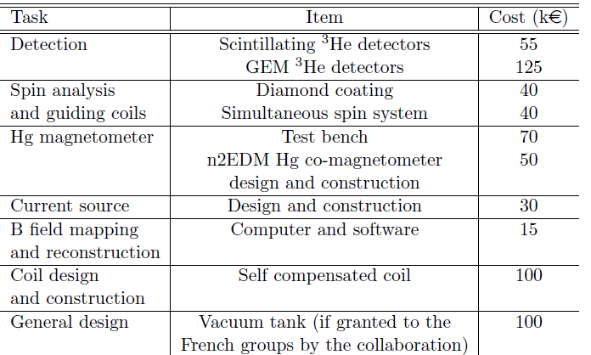
Funding
ANR application (535 k€)
 | 2014 | 2015 | 2016 | 2017 | 2018 | 2019
Equipment | 135 | 110 | 220 | 70 | 20 | 20
Travels + meeting + conf | 35 | 35 | 35 | 35 | 35 | 35
nEDM maintenance | 15 | 15 | 15 | 15 | 15 | 15
ANR grant application :
- pre-proposal submitted → 2014-2018
- budget: 535 k€ → exp. development
- in2p3 involvement:
travels + minimal technical developments
- in2p3 support
Conseil scientifique in2p3 24.10 .2013
Lefort Thomas – Interactions fondamentales – LPC Caen

Slide 22
Conclusion
International context:
- CryoEDM @ILL → 10⁻²⁷ e.cm level: but not running yet
- other experiments are waiting for their UCN source
PSI n2EDM project:
UCN source already started, improvements are actively pursued, strong PSI support
Any new technique or device can be tested within OILL spectrometer
→ allow producing real improvements for n2EDM spectrometer
Foreseen sensitivity: 2.10⁻²⁷ e.cm in 2022
(with current source performances)
Test of the generic
electroweak baryogenesis
Potentially achievable: 10⁻²⁸ ecm range
with UCN source improvement (factor 10 not understood yet)
Further constraints on SM extensions
Conseil scientifique in2p3 24.10 .2013
Lefort Thomas – Interactions fondamentales – LPC Caen

Slide 23
Magnetic field control
 | nEDM | n2EDM
Passive magnetic Shield: shielding factor | 1500 – 10000 (< 1 Hz) | 10⁵ (< 1 Hz)
Active surrounding field compensation (SFC): attenuating factor | DC field: 20 AC field: 5 – 50 @ 10⁻⁴ – 1 Hz | Uniform field (> 12 coils)
Correcting coils: internal field homogeneity | ~ 10⁻⁴ | < 10⁻⁵ (<10 pT)
Correcting coils: external field | Shield is magnetized | No ext. field
Active 3D field stabilization | - | Vector Cs
Current source: B0 drift during precession | ~ 200 fT | 100 fT
Field gradient | ~ 10 pT/cm | < 1 pT/cm
Residual field after degaussing (in situ) | < 2 nT | < 100 pT
Hg cohabiting magnetometer: sensitivity | 200 fT (lamp) | < 50 fT (laser)
External ³He magnetometer with Cs readout: sensitivity | - | Calcul: ~1 fT Exp: ~ 50 fT over 100 s
External vector Cs mag.: sensitivity | Scalar Cs: 50 pT | 1 pT
Thermo house (ΔT=0.2 K) knowing that ΔB = 2 pT/K due to shield dilatation
Electrodes degaussing @ PTB: < 50 pT @ 3 cm
Conseil scientifique in2p3 24.10 .2013
Lefort Thomas – Interactions fondamentales – LPC Caen

Slide 24
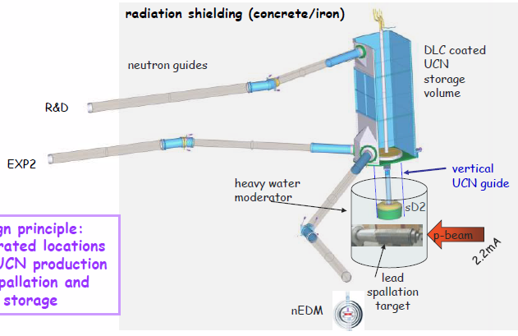
L
The UCN source @ PSI
P
C
CAEN
Conseil scientifique LPC, 17/11/2011
Lefort Thomas – Interactions fondamentales

Slide 25
International context
Running experiments:
  nEDM @ ILL (RAL Sussex): 10⁻²⁷ ecm in …
  - commissioning phase: first nEDM data in 2016 ?
  - UCN production within superfluid He → cryogenic issue slow down progresses
  nEDM @ ILL (PNPI): < 10⁻²⁷ ecm level in …
  - old PNPI spectrometer at PF2: 10⁻²⁶ ecm level in 2016 with EDM beam line
  - new storage chamber + new UCN source (reactor + SD₂) @ PNPI, not built yet
Planned experiments:
nEDM @ Munich: < 10⁻²⁷ ecm in …
- UCN source @ FRMII reactor, building ongoing (SD₂), experiment in 2016 ?
nEDM @ Oak Ridge (SNS):
- spallation + superfluid He, building ongoing, exp. not before 2020
nEDM experiment at RCNP/TRIUMF:
- spallation + superfluid He, building ongoing, experiment not before 2020
Conseil scientifique in2p3 24.10 .2013
Lefort Thomas – Interactions fondamentales – LPC Caen

Slide 26
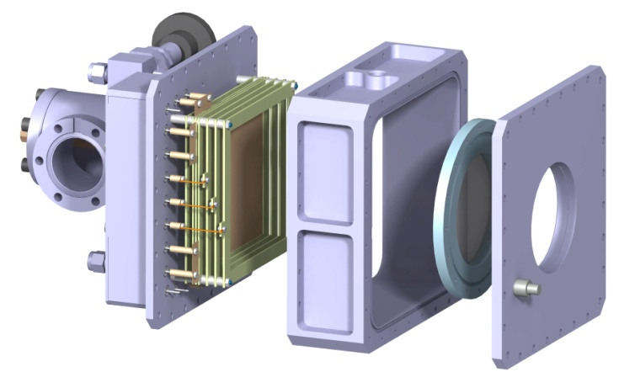
French laboratories involvement (LPC)
Detection: development of a new fast ³He gas detector
- lower gamma sensitivity and larger detection efficiency (~20 %)
- ability to handle large rate: up to few 10⁵ UCN/s
Two sealed versions are considered :
- HeGEM: induced current, readout performed with GEM
- HeScint: scintillation in CF₄, readout performed with PMT no gas contaminant, more stable
Combined with FASTER acquisition system
n + ³He → ¹H + ³H (+ 0.77 MeV)
  Status: HeGEM successfully tested with alpha source @ 1 MeV, 100 ns
  HeScint OK with alpha @ 5 MeV, 20 ns
  n2EDM: 4 detectors are required
Conseil scientifique in2p3 24.10 .2013
Lefort Thomas – Interactions fondamentales – LPC Caen

Slide 27
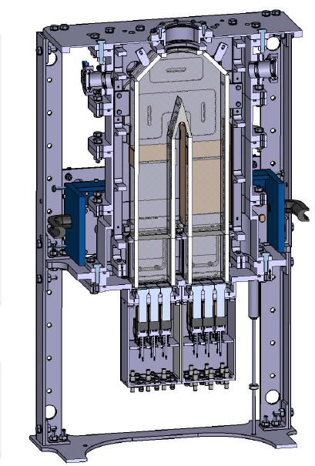
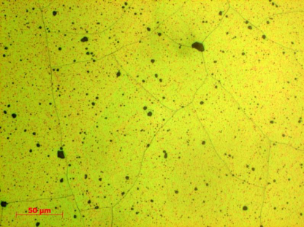
French laboratories involvement (LPC)
Spin analysis and guiding fields:
- holding fields along UCN path (E. Pierre thesis, 2012)
- simultaneous measurement of UCN polarization (V. Hélaine, ongoing PhD)
  Status: prototype (USSA) has been built
  → final tests this week
Former tests have already shown that:
- spin analysis is under control
- UCN transmission can be improved
Prospectives: diamond coating for the inner walls of the apparatus
major improvement if successful !
  Status:
  Fermi potential ~ 300 neV → 25 % higher than current coating
  Further tests in 2014 (LPC/PSI): storage chamber
Conseil scientifique in2p3 24.10 .2013
Lefort Thomas – Interactions fondamentales – LPC Caen

Slide 28
French laboratories involvement (LPC)
Coil design: new technique + double layers
→ field uniformity < 10⁻⁵
Magnetic field mapping:
→ 3D field map within vacuum chamber
  Status: prototype is studied (LPC/Kentucky)
  if funded, construction at LPC in 2014
  Status: keep on doing such activities
Conseil scientifique in2p3 24.10 .2013
Lefort Thomas – Interactions fondamentales – LPC Caen

Slide 29

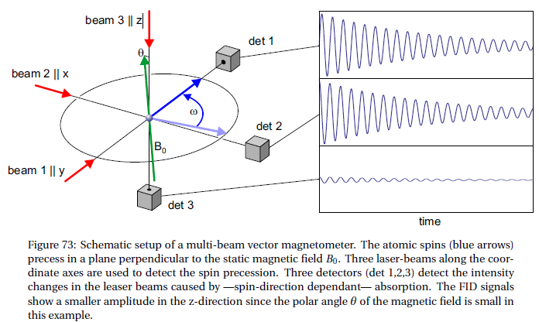
L
P
C
n2EDM: the new spectrometer
CAEN
Vector Cs magnetometer (Georg)
Field modulus: the frequency of the recorded FID signals
Field direction : amplitudes and relative phases of the three FID signals
Conseil scientifique LPC, 17/11/2011
Lefort Thomas – Interactions fondamentales

Slide 30
The measurement principle
Neutron Larmor frequency shift induced by electric field
Conseil scientifique in2p3 24.10 .2013
Lefort Thomas – Interactions fondamentales

Slide 31
n2EDM: general concept
  Passive multilayer magnetic shield + correcting coils system + magnetometers + ...
Removable coils system
Removable vacuum tank
(2m x 2m x 2m)
Fixed multilayer passive
magnetic shield
Conseil scientifique in2p3 24.10 .2013
Lefort Thomas – Interactions fondamentales – LPC Caen

Slide 32
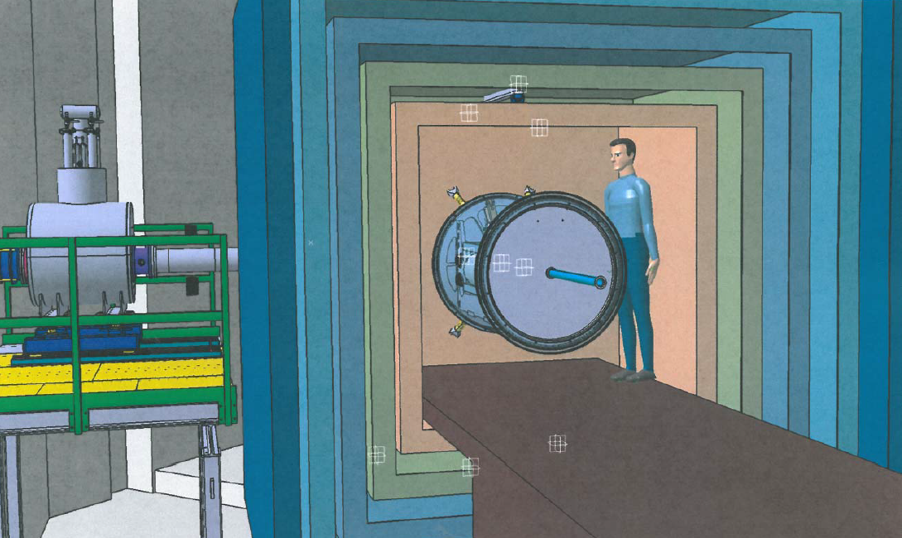
General concept
Conseil scientifique in2p3 24.10 .2013
Lefort Thomas – Interactions fondamentales – LPC Caen

